Slide 1
21st CCLC Applicant Workshop
Grant Competition - 2024

Slide 2
Workshop Agenda
Introductions
Overview of Grant
Detailed Review of RFA
Questions

Slide 3
21st CCLC
Grants are DUE on March 26th by 3 p.m.
One original and four copies (individually bound with rubber bands only)
AND
An electronic copy

Slide 4
Intent to Apply
Please turn in by February 15th
Not required but helps us prepare for application reviewers

Slide 5
What is a 21st CCLC Program?
Offers academic enrichment to children –
Particularly serves students in high poverty, low achieving schools
Goal is to meet state and local academic standards in core subjects (such as reading and math)

Slide 6
A 21st CCLC Program
Offers academic and youth development to students and their families when school is not in session (before school, after school, weekends, summer, holiday breaks, etc.)
Provides literacy and other educational services to families of participating students

Slide 7
21st CCLC Program
Provides students a broad array of other activities.
Examples:
Drug and alcohol prevention
Counseling
Art
Music
Dance
drama
Recreation
Technology
Character education programs,
Financial literacy
Career and technical programs
Internship or apprenticeship programs, etal.
7

Slide 8
Absolute Priority
Kansas is required to make awards only to those applicants that will primarily serve students where at least 40% of the students qualify for free or reduced cost meals.
Free and reduced percentages can be located on the “Data Central” page on the Kansas State Department of Education website (www.ksde.org) or directly at the following URL: http://datacentral.ksde.org/report_gen.aspx. (2023-2024 data)

Slide 9
Competitive Priorities
Competitive Priority I: (3 points)
Applicants that will serve students attending schools that have been identified as Comprehensive, Targeted or Additional Targeted Support and Improvement Schools
AND
that are submitted jointly with community-based and/or faith-based organizations or public or private organizations could potentially receive three (3) priority points.

Slide 10
Competitive Priorities (continued)
Competitive Priority II for Programming in the Northwest Region of Kansas: (10 points)
Eligible Counties: Cheyenne, Decatur, Ellis, Gove, Graham, Logan, Norton, Phillips, Rawlins, Rooks, Russell, Sheridan, Sherman, Thomas, Trego, Wallace (http://www.kcceoa.org/county-clerks/northwest/).
Applicants proposing to serve students attending schools in northwest Kansas could receive ten (10) priority points.

Slide 11
Competitive Priorities (cont’d)
Competitive Priority III for High School Programs: (3 points)
Applicants that specifically incorporate a College and Career Readiness component at the high school level could potentially receive three (3) priority points.

Slide 12
Program Operation Requirements (Elementary)
Elementary programs
Must operate a minimum of 300 hours per grant year (July 1 – June 30).
Elementary school applicants are strongly encouraged to provide this programming for at least 1.5 hours per day to provide consistency and to affect student growth.
Programs proposing less than 300 hours must provide justification in both the Need for Program and Quality of Program Design sections of the application.

Slide 13
Program Operation Requirements (MS/HS)
Middle School and High School Programs
Must operate a minimum of 250 hours per grant year (July 1 – June 30).

Slide 14
Program Time Requirements
Programs must include an after school component.
Transportation (to and from the program) as well as family engagement activities cannot be included to meet the 300 hours requirement.

Slide 15
Who Can Apply for a 21st CCLC Grant?
Any public or private organization may apply for a 21st CCLC Grant.
Examples of eligible applicants:
School districts, non-public schools, non-profit organizations, city or county government agencies, faith-based organizations, community-based organizations, institutions for higher learning, for-profit agencies

Slide 16
Applying for a NEW 21st CCLC Grant
A NEW Application should be completed if:
The applicant is applying for a SITE that has never received 21st CCLC funds;
OR
The applicant is applying for a SITE that has not received 21st CCLC funds within the past five years.

Slide 17
RE-Applying for a 21st CCLC Grant
A RE-Application should be completed if:
The applicant is in the fifth and final year of the current 21st CCLC grant cycle;
OR
The applicant has received 21st CCLC funds within the past five years.

Slide 18
Time Period for Grant
A 2024 Kansas 21st CCLC Grant cannot exceed five years.
Continuation from one year to the next, within the five years, is
contingent upon program performance and appropriations by Congress.

Slide 19
Size of Grants (New App)
By statute, the grant funds may not be awarded for less than $50,000 per year.
The maximum 2024 award is $150,000 for each of grant years 1-3.

Slide 20
Diminution of Funds (New App)
Funds will diminish during the 4th and 5th years of the grant.
Year 4 –
Kansas 21st CCLC Grant will pay 80% of the average of the first three years of the award.
Year 5 –
Kansas 21st CCLC Grant will pay 70% of the average of the first three years of the award.

Slide 21
Size of Grants (Re-App)
By statute, the grant funds may not be awarded for less than $50,000 per year.
The maximum 2024 award is $125,000 for each of grant years 1-3.

Slide 22
Diminution of Funds (Re-App)
Funds will diminish during the fourth and fifth years of the five-year grant.
Year 4 –
Kansas 21st CCLC Grant will pay $110,000
Year 5 –
Kansas 21st CCLC Grant will pay $100,000
*No financial match is required.
22

Slide 23
Re-Applicants (Grant Cycle 3 or 4)
Applicants that have completed at least two 5-year cycles of the grant are allowed to request the same budget amounts as a new applicant.
Years 1-3 – $150,000 per year
Year 4 – 80% of the average of the first three years of the award
Year 5 – 70% of the average of the first three years of the award

Slide 24
21st CCLC Transportation Allowance
Additional 21st CCLC Funding (Limited)
Applicants proposing to serve students in districts that are REAP (Rural Education Achievement Program) eligible may request up to $25,000 annually, in addition to the maximum grant award for transportation costs. (The additional allowance may only be used for daily transportation to and from the programs.)

Slide 25
Grant Application
The Request for Application (both NEW and RE-APPs) can be found on the KSDE website at: http://www.ksde.org/Default.aspx?tabid=740

Slide 26
Grant Submission
Hard copies need to be delivered to:
Christine Macy
Kansas State Department of Education
900 SW Jackson Street, Suite 620
Topeka, KS 66612
ATTN: 2024 21st CCLC GRANT
Hard copies must be received by 3 p.m. on March 26th.

Slide 27
Grant Submission (cont’d)
Electronic copy needs to be emailed to:
Christine Macy
cmacy@ksde.org
Subject Line: 2024 21st CCLC GRANT
Electronic copies (WORD format only – no Google Documents or PDFs will be accepted) must be received by 3 p.m. on March 26th.

Slide 28
Time for Questions
Questions?

Slide 29
Office Hours
February 28th
9-10 a.m.
https://ksde.zoom.us/j/86073430807
Meeting ID: 860 7343 0807
Passcode: 097660
March 9th
1-2 p.m.
https://ksde.zoom.us/j/85874688829
Meeting ID: 858 7468 8829
Passcode: 930497

Slide 30
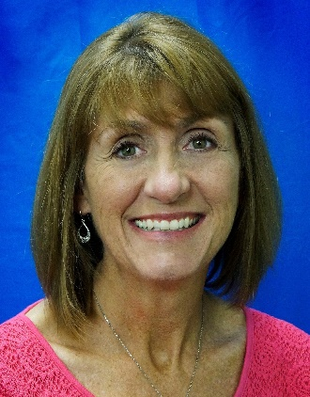
Contact Information
Any questions regarding the application process should be directed to:
Christine Macy
21st CCLC State Coordinator
cmacy@ksde.org
785-296-3287

Slide 31
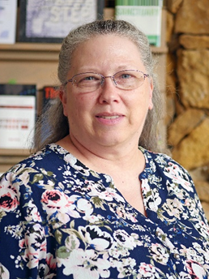
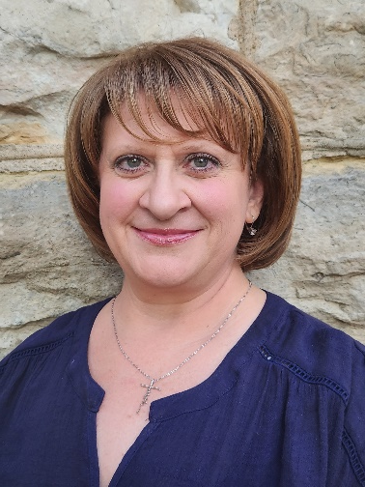
21st CCLC Team
Jamie Keiter
Research Project Coordinator
keiterj@ku.edu
Bonny Aureli
Research Project Specialist
baureli@ku.edu
James Martinson
Research Project Coordinator
James.martinson@ku.edu

