Slide 1
Marshall Middle School
Where Everyone Wants To Be: Building a Positive School Culture

Slide 2
Content
Participants will analyze specific ways to shift school culture and make school a place where students, staff, and parents want to be.
Participants will discuss ways to improve school culture in their buildings and/or classrooms.
Participants will examine aspects of their school culture which they teach and tolerate.

Slide 3
Process
What are some specific steps you have taken to improve culture in your building/classroom?
What might be some barriers to improving school culture that you have experienced in your building/classroom?

Slide 4
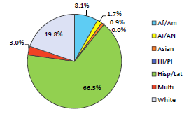
Projected Demographics

Slide 5
Reading Assessment Subgroup Data
Free and Reduced Lunch: +14.2%
ELL: +14.2%
African American: +43.8
White: +17.5
Hispanic: +10.4
SPED: +6.2

Slide 6
Problem Solving Process
Do
Do it. Execute the plan, implement changes taking small steps in controlled circumstances.
ACT
(Adjust, Continue, Transition)
A decision point. Take action to standardize or improve the process. Develop improvement hypothesis. Secure the improvement.
Plan
Plan ahead for change. Analyze and predict the results.
Check
Monitor and study the results. Track implementation impact and engage in performance improvement
dialogue.

Slide 7
Culture Shifts
We are here for the kids. We are here for each other.

Slide 8
Culture Shifts
Scheduling
  Core & Intervention
  Grade Level & Content
  Intentional Placement
Professional Development
  Data Driven
  Needs Assessment
  Looking out, not down (Travel)
Empowerment
  Building Capacity / High Expectations
  Shared Mission & Narrowed Focus
  Student Leadership / Family Engagement

Slide 9
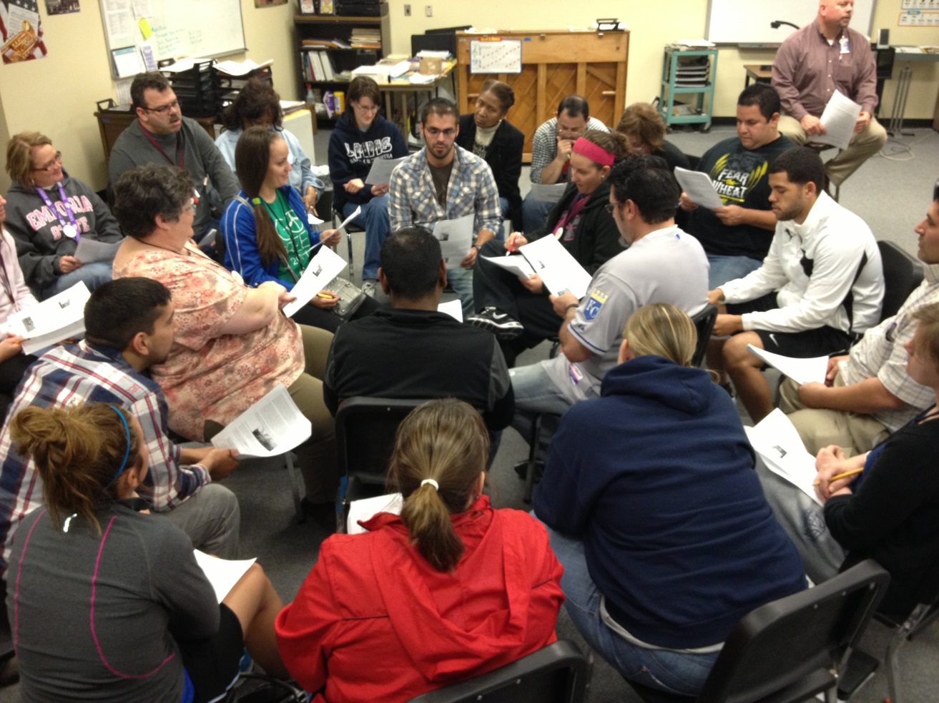
Scheduling for Core and Intervention
Intentional Placement
Data-Driven Decisions
and Accountability
Strengthening the Core: Explicit Instruction
Implementing Common Core in all Content Areas
AVID School-wide

Slide 10
Scheduling for Grade Level & Content
######### |  |  | Period 1 | Period 2 | Period 3 | Period 4 | Period 5 | Period 6 | Period 7 | Period 8 | Period 9
 |  |  | 8:00-8:50 | 8:53-9:38 | 9:41-10:26 | 10:29-11:14 | 11:17-12:00 | 12:03-12:46 | 12:49-1:34 | 1:37-2:22 | 2:25-3:10
6th Grade Team
S. Knutson | LA | 128 | LA 6 1361/2 611 Rm 128 CWC | PLAN | LA 6 1361/2 603 Rm 128 | LA 6 1361/2 604 Rm 128 | TEAM | Lunch | LA 7 1371/2 717 Rm 128 | LA 7 1371/2 718 Rm 128 CWC | LA 6 1361/2 609 Rm 128
S. Welch | LA | 125 | Hon LA 6 1363/4 601 Rm 125 | PLAN | Hon LA 6 1363/4 603 Rm 125 | AVID XL 6 9058-604 Rm 125 | LA 6 1361/2 605 Rm 125 | Lunch | TEAM | Q1/Q2 MS101 9034-18/28 | Hon LA 6 1363/4 609 Rm 125
S. Hankins | Math | 126 | Math 6 2331/2 611 Rm 126 CWC | Hon Math 6 2367/8 602 Rm 126 | Math 6 2331/2 613 Rm 126 | Math 6 2331/2 604 Rm 126 | Hon Math 6 2367/8 665 Rm 126 | Lunch | TEAM | PLAN | AVID XL 9057-605/9058-068 RM 126
S. Bhakta | Math | Float | Math Intv 6 2351/2 601 Rm 306 | Math Intv 6 2351/2 622 Rm 301 | Math Intv 6 2351/2 623 Rm 301 | Math Intv 6 2351/2 624 Rm 304 | Math Intv 6 2351/2 605 Rm 300 | Lunch | TEAM | PLAN | Math Intv 6 2351/2 619 Rm 216
J. McHugh | Math | 124 | Math 6 2331/2 601 Rm 124 | Math 6 2331/2 612 Rm 124 CWC | M Intv 6 T3 2351/2 633 Rm 209 | Math 6 2331/2 624 Rm 124 | Math 6 2331/2 605 Rm 124 CWC | Lunch | TEAM | PLAN | M Intv 6 T3 2351/2 629 Rm 209
C.Penner | SCI | 106 | SCI 6 4891/2 601 Rm 106 | SCI 6 4891/2 602 Rm 106 | SCI 6 4891/2 613 Rm 106 | SCI 6 4891/2 614 Rm 106 CWC | SCI 6 4891/2 605 Rm 106 CWC | Lunch | TEAM | PLAN | SCI 6 4891/2 609 Rm 106 CWC
T. Marten | SS | 108 | SS 6 3011/2 601 Rm 108 | PLAN | SS 6 3011/2 603 Rm 108 | SS 6 3011/2 604 Rm 108 | SS 6 3011/2 605 Rm 108 | Lunch | TEAM | SS 7 3041/42 728 Rm 108 | SS 6 3011/2 609 Rm 108
Language Arts
Math
Science
Social Studies

Slide 11
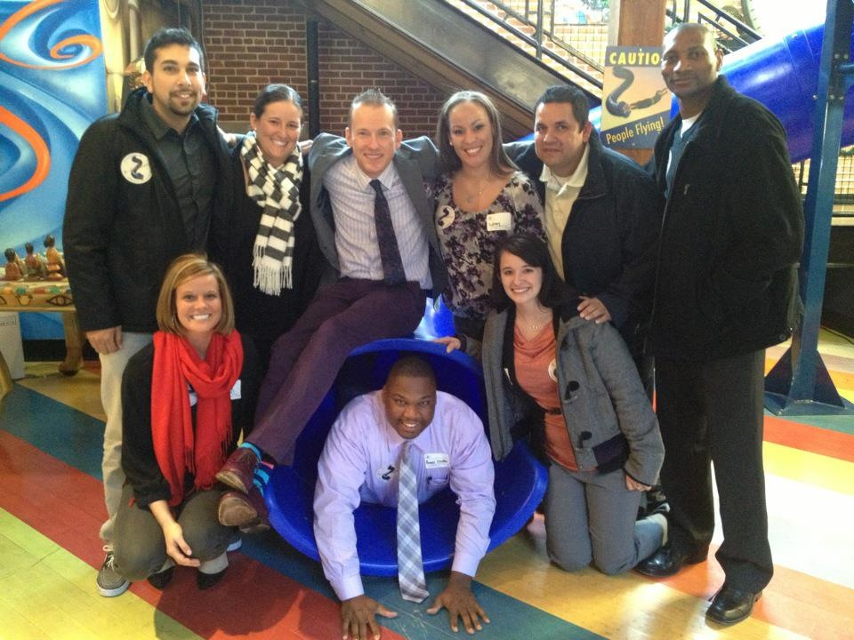
Professional Development
Ron Clark Academy (Atlanta)
Safe & Civil Schools Conference (Portland)
Harvard Urban School Leadership (Boston)
Plain Talk About Reading (New Orleans)
Explicit Instruction TOT (Wichita/Anita Archer)
CHAMPs TOT (Wichita/Mike Booher)
Summer Paid Professional Development Opportunities
Love & Logic (Wichita)
Building Capacity – Staff Presentations In-Service, District In-Service & Learning Labs, National Conferences (Orlando – America’s Choice National Conference)
AVID Summer Institute (Dallas)

Slide 12
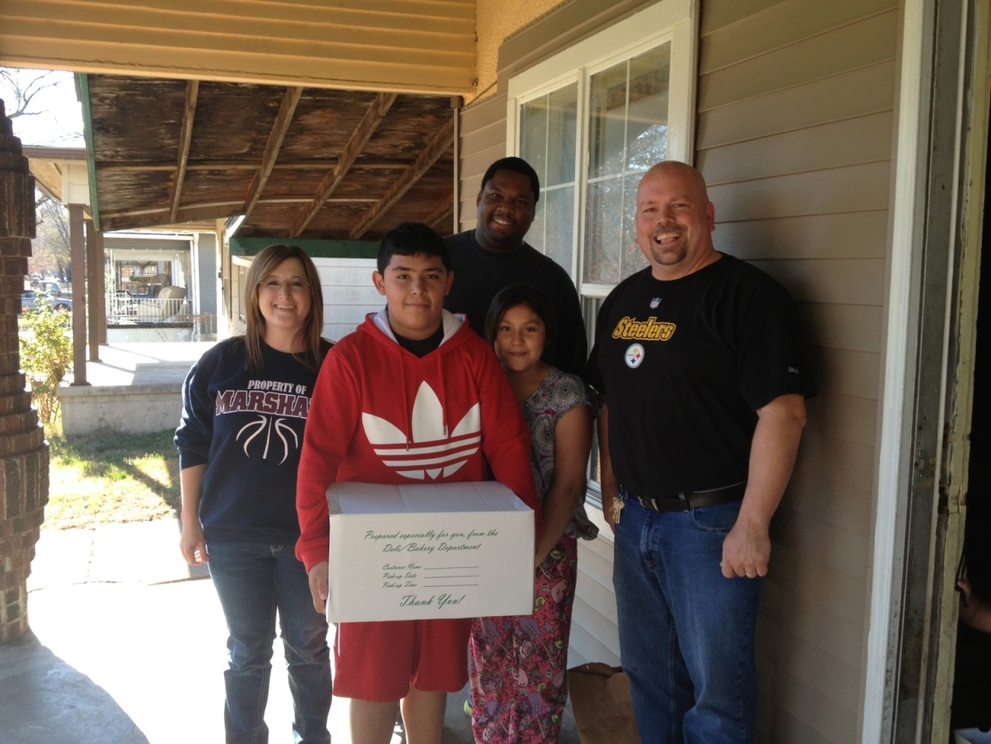
Where are we going…
Empowerment
Empowering Stakeholders
School Stat Sessions
Informed Leadership: Principal Perspective
Full-Time Family Engagement & Community in Schools Staff

Slide 13
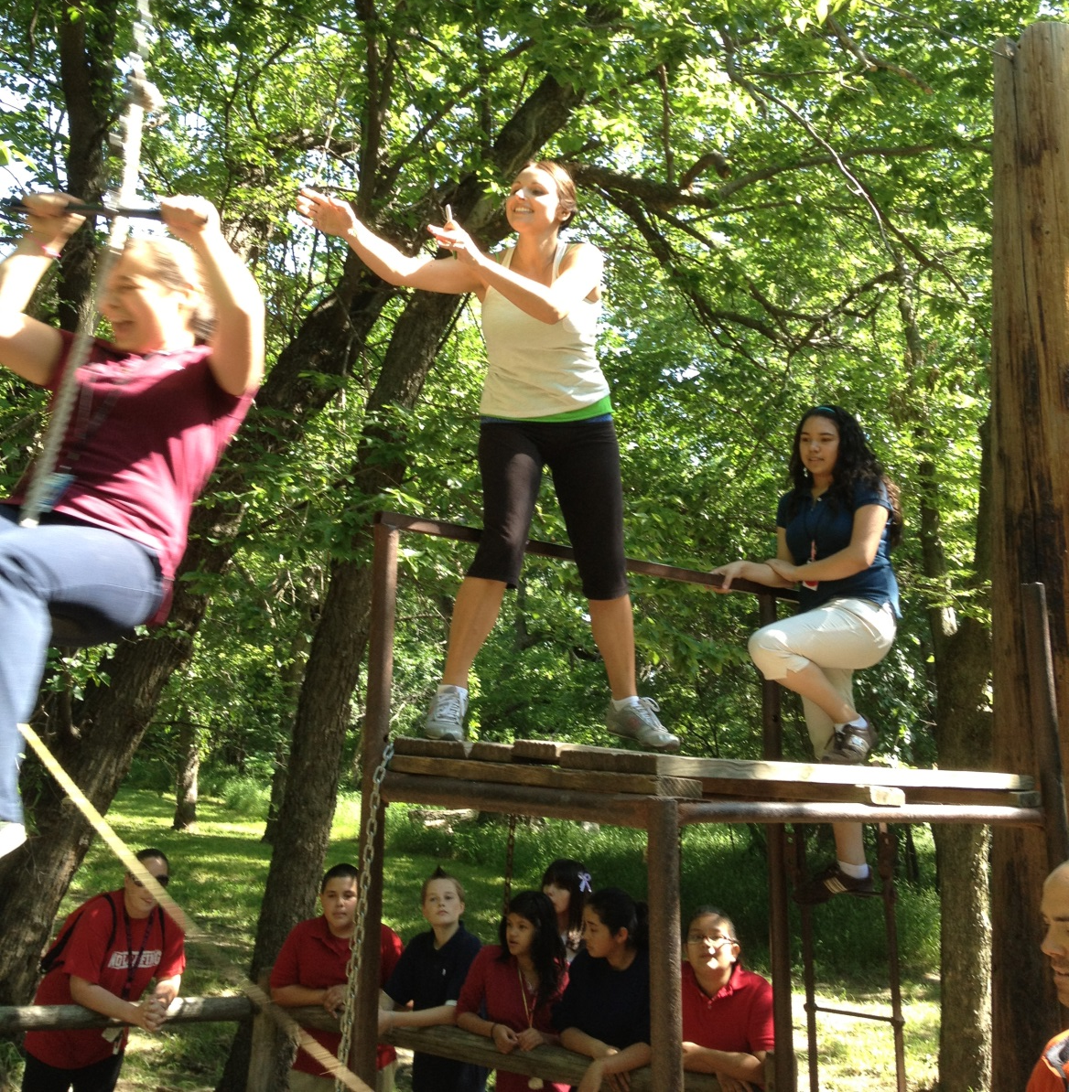
Empowerment
Standardized Documentation Tool for Academic/Behavior Data (OneNote)
Behavior Specialist on
staff
Full-time Counselor
Continued Training on Tiered Behaviors
Book Study: Discipline in the Secondary Classroom & Explicit Instruction
Grade Level Team Time weekly devoted to academics/behavior

Slide 14
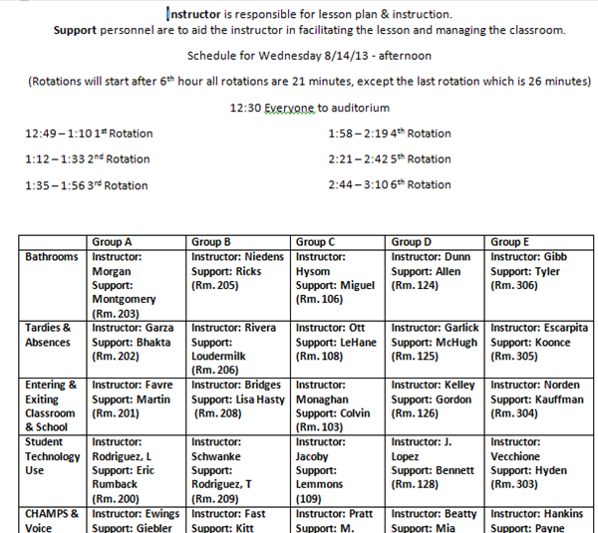
Rotation Document

Slide 15
6th Grade Red Carpet Event

Slide 16
Process
Culture – you either teach it or tolerate it. What do you teach? What do you tolerate?
What have you seen today that may help you overcome those barriers mentioned earlier?

Slide 17
Thank You!
Ron Stubbs, Principal rstubbs@usd259.net
Leslianne Craft, Asst. Principal lcraft@usd259.net

