Slide 1
Kansas Education System Accreditation
Chair Training Winter 2018-2019
Teacher Licensure and Accreditation | Kansas State Department of Education | Landon State Office Building 900 SW Jackson St., Suite 117, Topeka, KS 66612 |785-296-4948 | jnobo@ksde.org

Slide 2
Activator: We Connect
Find your partner/group
Introduce yourselves:
Name, location, position, system you are chairing
What is one thing you want to get out of this training?
What are one or two questions you want to know?
Post questions on chart paper
If you finish before schedule, have some fun with the cards, and discuss the questions and get to know each other better
Notes:
This activity should not take more that 15 minutes.
1-3 minutes instructions
5-10 minutes activity
1-2 minutes to post questions

Slide 3
Kansas Vision for Education
Kansas leads the world in the success of each student.
Notes:
The State Board of Education’s vision. Talk about community meetings/tour and information it yielded for this vision. Talk about how KESA is a way to create change in districts and move to redesign of schools.

Slide 4
State Board Outcomes for Measuring Progress
Kindergarten Readiness | Individual Plan of Study | High school graduation | Postsecondary Success | Social-emotional growth measured locally
Notes:
Rather than using a single measure (i.e. state assessment), the SBOE has selected 5 outcomes to measures and determine how successful is the system. These outcomes came out of the community/meeting tours.
Talk about connection of KESA and Board Goals…Results “R” of 5 “R” Rubric
KESA accredits at the System (district) level to create systemic change within and among school buildings across the district.
Systems need to redesign and pursue a continuous improvement process at both the district and school levels.
The School Redesign Project at the Kansas State Department of Education and KESA work together to create system changes to support the State Board Outcomes.
Buildings can not be part of the School Redesign Project without commitment from their Superintendent, Board, community and staff. KESA can not create change if these pieces are not in place, that is why in KESA stakeholder involvement is critical.

Slide 5
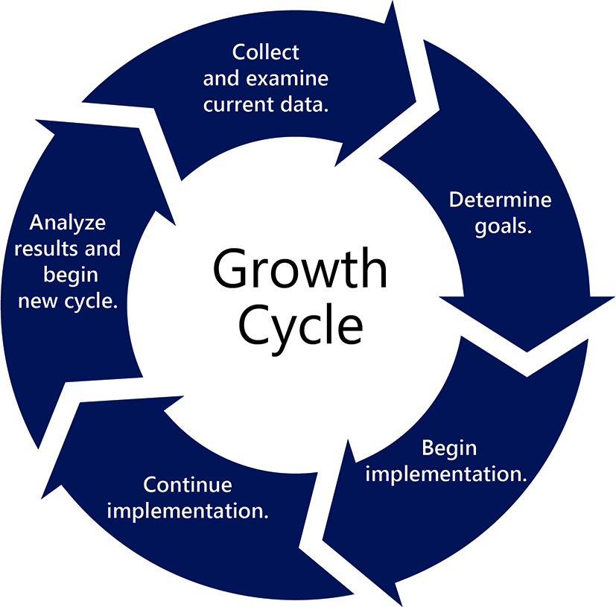
KESA Continuous Improvement Cycle for System Redesign
Notes:
Some improvement cycles may look different because they have more steps, depending on model used. However, they can all be boiled down to these five areas. (may discuss here Redesign, AdvancED, KLN, etc.)
Five-step growth process
Multiple measures
Educational framework (The Five Rs)
Foundational Structures
Compliance
Stakeholder participation

Slide 6
Today’s Outcomes
Understand and gain knowledge of:
OVT Chairs Expectations
KESA Logistics
KESA Visit Expectations
System Goal Reviews
Data Review Expectations
Effective Report Writing
Notes:
Compare outcomes to results from activator activity. If something from activator isn’t covered in presentation, add to a parking lot list to address during a Q&A at some point in the day, if appropriate, or talk with individual during a break
Additional notes:
Process – We will examine KESA as a process for whole system improvement and also as the only route to state accreditation
KESA and Redesign – Understand the relationship between the two (we need to add more re: relationship here)
Logistics and responsibility – Understand what are the requirements of the process and responsibility of the system each year in the process.
Resources – Review KESA resources on website and obtain information on resources needed.

Slide 7
What is the role of OVT Chairs in the KESA Process?
Notes:
Say we are going to start first with the definition of OVT as a whole.

Slide 8
Outside Visitation Team
The group of education professionals charged with coaching, mentoring, and supporting a district/system for the duration of the system’s accreditation cycle.
Notes:
Within this group your role is to be the OVT lead for the visit.
Now we will examine the role of the chair in relation to:
System
ARC
KSDE

Slide 9
Chair Role with System
Collaborate on agenda
Coach, mentor, provide support
Give feedback and next steps
Provide OVT Annual Summary Report
Notes:
Although the OVT report is a summary of visit, it should provide the system with next steps
Talking Points: Provide clarity and help provide supports
Agenda = it is the System Accreditation so the System should take the lead
Assist the OVT members through coaching, mentoring and supporting

Slide 10
Chair Role with KSDE
Authenticated Application
Keeping KSDE Apprised of Chair Status
Training
Support
Notes:
Providing OVT Yearly Summary
Attend trainings and keep up to data with KESA
Seek support as needed

Slide 11
OVT Chair Responsibilities
Review of System Report
Agenda Setting with System
Contact to OVT Members
OVT Annual Summary Report
Notes:
Verify team notification
Ensure that OVT has copy of Year # System Update
Dialogue with OVT prior to visit
Assign roles
Collaborate on Annual OVT Summary

Slide 12
OVT Visit Logistics
Communicate with system/district
Agenda
Collaborate with system/district
Decide on length of visit
Focus agenda around need and support
Arrange for focus group/stakeholder meetings
Decide on building tours (purposeful)
Notes:
What model of improvement is being used: KLN, AdvancED, Redesign
Length of visit should be no less than ½ day. Length of day should be based on need. If you are doing focus groups it may be a longer day. Don’t shortchange the process.
Focus group/stakeholder meetings purpose is to gather information of involvement and knowledge of accreditation process and system changes for student growth
Building Level Team Meetings
Community/Business Stakeholders
Student Groups (All levels), parents, teachers
District and Building Site Council members
Building tours should be purposeful. Maybe highlighting student learning or changes taking place in school and district based on goals. Try not to/don’t preplan classroom visits that are not doing consistent strategies.
Sample agendas are currently in the OVT Workbook.

Slide 13
OVT Visit Logistics (Continued)
Identify questions that will guide discussion
System and focus groups
Complete Visit
Submit OVT Annual Summary Report
Follow-up with system as needed.
Notes:
What model of improvement is being used: KLN, AdvancED, Redesign

Slide 14
KESA and Redesign
Activity: Read explanation of KESA and Redesign
What is clear?
What is unclear?
Discuss ways to ensure “one system/process”.
Notes:
Activity 1: Jigsaw or place in groups to read KESA and Redesign explanation (15 -20 minutes (3-5 to read and 5-7 to discuss and 5-7 to debrief) Page 58 – 61.

Slide 15
OVT Visits: What do these involve?

Slide 16
Prior to Visit
Read System Yearly Update
Initial and Final Reports
Contact system
visit date
reminders
System Yearly Update Clarification
Notes:
Be Prepared and Read System Annual Update and ask yourself:
What is clear and what is not clear?
What is needed from System?
Stakeholder visits?
School Visits?

Slide 17
Prior to Visit (Continued)
Agenda setting
Phone call with OVT members
Redesign Project
Notes:
Agenda Setting
Decide on length of visit
Focus agenda around need and support
Arrange for focus group/stakeholder meetings
Decide on building tours (purposeful)
Phone call with OVT Members
Discuss Report
Assignment of Responsibilities
Review logistics of visit and share agenda

Slide 18
Reviewing a System Yearly Update Report Prior to Visit
Notes:
Activity 2: review System Yearly Update Reports to identify questions to be asked and looking at comprehensiveness of Report. (30 Minutes)
Identify the year of systems being reviewed by chairs present at training.
Group chairs by year of System being chaired
Provide each group with a copy of a their year’s System Yearly Update
Each group can review a section of the report
Have them discuss the report and identify a recorder, answering the following questions:
What questions would they ask
What needs clarification
What evidence would they like to see at the time of visit
What stakeholder groups would they like to visit
What schools would they like to visit and with what purpose.

Slide 19
System Yearly Update Activity Questions
Discuss the report with these questions in mind:
What questions would you want to ask?
What needs clarification?
What evidence would you like to see?
What focus groups would you like to visit?
What schools would you like to visit and with what purpose?
Notes:
Activity 2: review System Yearly Update Reports to identify questions to be asked and looking at comprehensiveness of Report. (30 minutes)

Slide 20
During the Visit
Vision/Mission
Stakeholder and Focus Groups
School Visits
Needs Assessment or Evaluation Data
System and Building Goal(s) Review
Notes:
What’s their why? This is something that probably should be asked every year…Do they still have the same why

Slide 21
Vision/Mission
Why Improve
Clarity
Stakeholder involvement and commitment
Culture of system/district and community
Notes:
Does the System and its stakeholders understand “why the need for change/redesign”
How were stakeholder’s involved in process
Is there a clear understanding of the need for change and redesigning of system?
What is the culture of the System and Community? (Patterns of beliefs and assumptions that the faculty share about the school and their place in it. Patterns, practices, values and artifacts that specify for all stakeholders who they are and how they are to function).

Slide 22
Stakeholder/Focus Groups
Purpose
Perception and understanding
Timeframe and structure of meeting(s)
Notes:
Meet with purpose…questions should focus on whether the stakeholders or focus groups understand what is going on, their involvement in process, perceptions of process and work system is doing.
Understand the level of buy in and understanding of change efforts and redesign in the accreditation process.
Timeframe – 45 minutes
Structure – Dependent on size of district about 10-15 members, for students about 2 or 3 from each grade level,

Slide 23
School Visits
Purposeful
Outliers
Culture, Diversity, Equity
Notes:
Don’t visit a school just to visit. What do you want from these visits? What’s the culture of the school?

Slide 24
Needs Assessment
A systematic process for determining and addressing needs, or "gaps" between current conditions and desired conditions or "wants". The discrepancy between the current condition and wanted condition must be measured to appropriately identify the need.
Notes:
Although accreditation is at a system level, buildings should do their own needs assessment that as an aggregate could inform System needs and goals. The System Goal Area should reflect the needs of the buildings and their priorities need to be broad enough to ensure that building needs are represented. Each building will also have goals reflective of their needs assessment and in alignment with the System plan. Building plans are to improve student learning at the building level but also impact improvement of the state board goals/results. System Accreditation is a combination of process and data. The data is the aggregate of all building level data reviewed (State Board Outcome data, attendance, Compliance, State Assessment data). The System needs to ensure that outlier schools are also included and considered in the improvement process.
Goals should align with needs assessment findings
Needs assessment at building and district level, each inform each other.

Slide 25
Needs Assessment
Needs Assessment
Quantitative
Qualitative
Planning Process
Used for Improvement
Assessments
Graduation Rates
Rubrics
Surveys
Notes:
Review other types of Quantitative and Qualitative Data
Quantitative: State Assessment, Map, ACT,
Qualitative: Surveys (beliefs), Inventories (reality/experience)
Evaluations, various plans
Goals should align with needs assessment findings
Needs assessment at building and district level, each inform each other.

Slide 26
System goals
Building goals
Building goals
Building goals
Notes:
Discuss how system goals are to be written and its relationship with the building goals and the State Board Outcomes.
Show handout example

Slide 27
What makes a Good Goal?
Specific
Measureable
Accountable
Relevant
Time-Based
Notes:
Don’t need to write smart goals but it is what needs to be considered for a good goal.

Slide 28
Action/Improvement Plan
System – Two “Rs”
Broad goals that can support building goals
System goals based on building needs
Strategies focused on system improvements and building supports
Building goals based on needs assessment and aligned with system/district goals
Notes:
R’s based on needs assessment which included building needs assessment information.
continuous improvement should be done in a rigorous and thoughtful manner. It should also be transparent. It should be reviewed regularly and frequently, should have depth, and context. It means not doing the same work differently, but doing different work. Although KESA has certain “compliance” requirements, it also allows for Systems to decide on what to focus their improvement process to help change/redesign their system and providing evidence of such change through growth in the data relevant to the State Board outcomes (System accountability).
KESA requires a continuous improvement process that brings into play various stakeholders for the purpose of having a collective impact on student learning and growth.
Systems with redesign schools need to ensure that the redesign goals are aligned with the R’s. This should not be a problem since the redesign principles fit within all the R’s.

Slide 29
Understanding the Data
What data is system using
Relating the data to system, school goals and progress
Data analysis and review
Notes:
What will success look like?
Types of data: formative and summative
Formative: Ongoing. It informs A system should be continually gathering evidence to monitor how their strategies are working.
Summative: Summarizes…was the outcomes/goals met?
Data and goal review Activity within 5 slides

Slide 30
Analysis
Notes:
Monitor, Adjustments, Review, implementation. Is what I am doing working.
If not working, what was the fidelity of the implementation? This is very important.
Fidelity questions: Are the activities being done throughout all buildings?, How many schools or classrooms are implementing the strategy?
Talk about evaluation of plan and evaluation of board goals

Slide 31
KESA Goal Review
What evidence was used to select goal?
What is the goal trying to accomplish?
What professional development is needed?
How will it be known if the goal is accomplished/met?
How will the goal be monitored & re-evaluated?
Notes:
Goals reflect or are written documentation of what you are doing for improvement. Should include professional learning and as such, that is professional learning should be reflected and aligned in your 5 year PD plan, be specific about your PD and think long term.
Talk about the components of a good Improvement Plan:
Smart Goals: Specific, Measurable, Attainable, Relevant, and Time-based
Specific Target, measurable activities/strategies that are realistic, activities aligned to target, person responsible, timeline, resources, professional development, evaluative data.
Although your plan will be goal area specific…2 R’s, know that you will need to be prepared to discuss with your visiting team how all goal areas are being sustained while emphasizing the two specific R’s..
e will have some practice on this.

Slide 32
Data Review, Goals and Improvement Plans
What does the data tell you?
What other local data would you like to see?
Do the goals match the data?
Will goal help the district change?
Will the data provide good measures of growth in their goals?
What questions would you have of a district, schools?

Slide 33
After the Visit
Time to write report onsite
Report writing logistics
Timeframe
Notes:
Report Writing Logistics:
Have a discussion about the visit, using the questions of the OVT Annual Summary Report as a guide.
Decide on whether you are writing the report or if you are going to give each team member a responsibility for a question.
Be sure everyone has your email so they can send you’re their write-ups
Be sure everyone has a computer
Timeframe: No later than 30 days after visit. If year five sooner is better.

Slide 34
Writing the Report
Purpose of Report
Results Based Evidence
Change as Evidenced by Data
Growth Terms
ARC Expectations
Notes:
To provide feedback to the System on your assessment of what you saw.
Provide evidence of areas which can be worked on
Make suggestions for areas of concern
Use action verbs and growth terms
state evidence of what you saw
For the ARC: ARC will be using the report to determine is the system is working appropriately through the accreditation process. The report provides evidence of success and improvement needs.

Slide 35
What Makes a Good Report
Clarity in writing
Examples/evidence/data
Answers the question
Provides observations of the system’s progress
Highlights decisions, discussions and interviews
Provides support…Where to next
Summarizes visit
Notes:
Report Writing Activity

Slide 36
Report Writing Activity
Does this report provide sufficient information for the ARC?
Is anything missing?
How would you change it?
Notes:
Activity 5: Put Chairs by year and have them look at reports and review as a group…Is this a good or bad report? Why? Is anything missing? How would you change it?

Slide 37
Chair Role & Accreditation Review Council (ARC)
OVT Report
Suggestions for improvement
Clear and concise
Notes:
OVT Report year 5 is a summary of the current year’s visit and should also provide an overall summary of the system’s progress throughout the five year process. Although it should provide input to the system about next steps, it also needs to provide direction for the ARC as they review the system during the accreditation visit.

Slide 38
Today’s Outcomes
Understand and gain knowledge of:
OVT Chairs Expectations
KESA Logistics
KESA Visit Expectations
System Goal Reviews
Data Review Expectations
Effective Report Writing
Notes:
Review Outcomes in light of presentation to verify all outcomes where addressed.

Slide 39
Training Evaluation
https://bit.ly/2R8hUEb

Slide 40
Contacts
Accreditation email – accreditation@ksde.org
Mischel Miller Jeannette Nobo Bill Bagshaw
Director, TLA Assistant Director Coordinator
785-296-8010 785-296-4948 785-296-2198
mmiller@ksde.org jnobo@ksde.org bbagshaw@ksde.org
David Barnes Lynn Bechtel
Accreditation Consultant Professional Development Consultant 785-368-7356 785-296-8110
dbarnes@ksde.org lbechtel@ksde.org

Slide 41
The Kansas State Department of Education does not discriminate on the basis of race, color, national origin, sex, disability, or age in its programs and activities and provides equal access to the Boy Scouts and other designated youth groups. The following person has been designated to handle inquiries regarding the nondiscrimination policies: KSDE General Counsel, Office of General Counsel, KSDE, Landon State Office Building, 900 S.W. Jackson, Suite 102, Topeka, KS 66612, (785) 296-3204

