Slide 1
Kansas Multi-tier System of Supports – a Comprehensive, Integrated, Three-tiered Framework of Prevention
System Level Change across the Classroom, School, District and State
2015 KEEN Conference

Slide 2
We will discuss…
KSDE Vision
Kansas MTSS – Past, Present, Future
Components of MTSS:CI3T
Overview 2015-2016 MTSS: CI3T Training Series

Slide 3
KSDE’s Vision
All schools (preschool through high school) use a multi-tier approach that addresses behavior, social and academic domains simultaneously.
Meaningful data are collected and used to make decisions regarding programming.
Social curricula and behavioral framework are taught with as much rigor and fidelity as academic subjects.
Schools closely examine what is already in place then determine what needs to be revised or added, based on data.

Slide 4
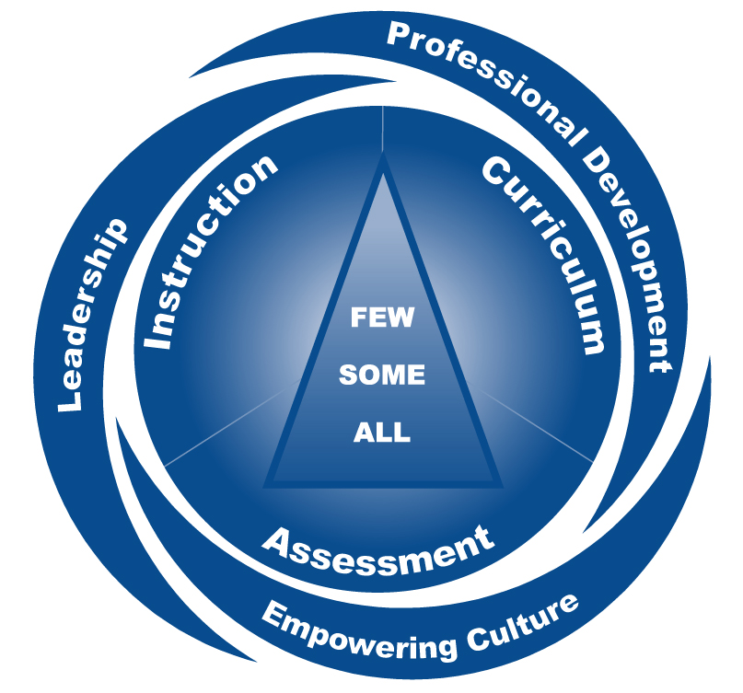
What is Kansas MTSS?
A coherent continuum of evidence based, system-wide practices to support a rapid response to academic, behavioral and social needs with frequent data-based monitoring for instructional decision making to empower each Kansas student to achieve high standards.
MTSS Structuring Behavior Supplement Kansas MTSS (August 2013) - KSDE Part B Funded
Notes:
As we move along you will see the triangle embedded in the hurricane
Supportive system You may have already started drawing some coorelations between a culture of prevention and MTSS
Definition of MTSS
There is no KSDE requirement for schools to do MTSS
Discuss use of term evidence-based
-----------------------------
The definition of MTSS is: A coherent continuum of evidence based, system-wide practices to support a rapid response to academic and behavioral needs with frequent data-based monitoring for instructional decision making to empower each Kansas student to achieve high standards.
This definition was developed by a state-wide stakeholders group convened in July 2007 by KSDE. KSDE recognizes that MTSS really is a grassroots effort started by innovative educators in our state. KSDE seeks to continue to support your efforts as you evaluate and refine your system of supports for students.
Key terms within the definition that begin to set the tone for MTSS include:
-coherent continuum
-system-wide
-academic and behavior
-data-based monitoring for instructional decisions
he Kansas MTSS is an overarching
framework that guides schools through a process of needs assessment
and decision making that assists in not only selecting effective
practices, but also creating a sustainable aligned system. Schools use
an MTSS as the framework for the school improvement process to
address the academic and behavioral achievement of all students

Slide 5
Goals of Kansas MTSS
To provide an integrated systemic approach to meeting the needs of all students.
To become the guiding framework for school improvement activities to address the academic, behavioral and social achievement of all students.
MTSS Structuring Module 1 Leadership (August 2013) - Kansas MTSS KSDE Part B Funded
Notes:
work more efficiently and avoid addressing domains separately
minimize a silo approach and maximizes a collaboration
Lane, K.L., Oakes, W., Jenkins,, A., Menzies, H.M., & Kalberg , J.,(2014) A Team-Based Process for Designing Comprehensive, Integrated, Three-Tiered (CI3T) Models of Prevention: How Does My School-Site Leadership Team Design a CI3T Model?, Preventing School Failure: Alternative Education for Children and Youth, 58:3, 129-142,
Emphasis on integration
Emphasis on being systemic
Emphasis on being the overarching framework for school improvement
For schools with academic excellence as well as those who may be struggling
For schools to support the areas of reading, math and behavior.
------------------------------
The goal of MTSS is to provide an integrated systemic approach to meeting the needs of all students. To achieve this, resources must be used in an effective and efficient way to enable every student to be successful. Most importantly, MTSS does not necessarily require additional resources or adding on to existing practices. Instead, it involves evaluating current practices to identify those that yield evidence of effectiveness, addressing areas that are missing, and replacing ineffective or inefficient approaches with those that are supported by research and address an area of need.

Slide 6
Why Multi-Tier System of Supports?
Addresses general academic underachievement
Addresses increased difficulty with classroom and behavior management
Ensures equitable access to the content areas
Creates system of responses when difficulties are encountered
Breaks down “Silo Effect” of previous initiatives
Increased continuity between grade levels and buildings within district
Notes:
Cover items on slide and lead teams in a discussion regarding whether they are experiencing any of these difficulties
Start with national perspective
Acknowledge the high achievements in our state and our high standards/expectations
What about students not at proficient? Is it enough to have the majority of our students proficient and above? What about those students who barely made it? Do you have students who scored proficient but you are still concerned about? Their comprehension level? Their reading proficiency?
----------------------------------------------------
.

Slide 7
Partners
The CI3T framework was previously developed and implemented in other systems by Dr. Kathleen Lane and colleagues prior to coming to the University of Kansas. A partnership between Keystone Learning Services and Dr. Kathleen Lane at the University of Kansas and Dr. Wendy Oakes at Arizona State University, was established in August of 2012 to move forward the efforts of an integrated approach to academic, behavioral and social skill programming.
Dr. Kathleen Lane
Dr. Wendy Oakes
The MTSS Core Team/ MTSS: CI3T State Team and other TASN providers have worked closely with Dr. Lane, and Dr. Oakes, and their colleagues to blend the work in Kansas.

Slide 8
Past, Present, Future
Building on a foundation of a multi-tier system of supports (MTSS), this work involves integrating the design, implementation and evaluation with a CI3T approach to address the academic, behavior, and social skills needs of students.
This is referred to as: MTSS: CI3T

Slide 9
The Next Generation of MTSS
MTSS
MTSS Recognized Facilitators
Addressing academic and behavior domains separately
Schools moving forward with change without the district commitment secured for sustainability
No application/pre-requisites
MTSS: CI3T
MTSS State Trainers/Coaches and District/Building Coaches
Academic, behavior, social domains are blended
Confirmed district commitment and active participation
Application process, exploration phase
MTSS for Reading
MTSS for Math
MTSS for Behavior
MTSS:CI3T
Notes:
You can still access these evidence-based practices, but in MTSS: CI3T all three will be integrated into one system

Slide 10
Why a Prevention Framework is Needed
Antisocial behavior patterns are most malleable before age 8 (Walker, Ramsey, & Gresham, 2004)
Students’ academic success is highly dependent on academic enablers (engagement, interpersonal skills, study skills, and motivation) (DiPerna & Elliott, 2002)
Academic intervention at 3rd or 4th grade takes 4 times longer than if delivered at kindergarten (Lyon, 1998)
1 in 6 children not reading proficiently at 3rd grade do not graduate from high school on time (Hernandez, 2011)
Nationally, 68% of 8th graders and 64% of high school seniors failed to become proficient readers (Deshler, 2004)
Notes:
Slide 10: I suggest the title, “Why a Prevention Framework for Academic, Behavior, and Social Skills Are Needed” or something….or maybe this is my lack of understanding of why academics is separate from “prevention framework.”
REMOVED: 97% of teachers confirmed that good discipline and behavior are necessary for school success (Public Agenda, 2004) -EDS
The impact of failing to intervene early
A system that is preventionfocused addresses this issue
Think about adding Moats quote that 2/3 of these students come from college-educated homes.
-------------------------------
These are two facts that should hit home with teams, and explain why it is important to commit resources to early intervention.
From Donald J. Hernandez, April 2011
One in six children who are not reading proficiently in third grade do not graduate from high school on time, a rate four times greater than that for proficient readers.
The rates are highest for the low, below-basic readers: 23 percent of these children drop out or fail to finish high school on time, compared to 9 percent of children with basic reading skills and 4 percent of proficient readers.

Slide 11
Why a Prevention Framework is Needed (cont’d)
Given school-based violence and the multiple needs of students with and at risk for EBD:
It is essential that evidence-based programs be implemented to prevent and respond to instances of antisocial behavior.
Academic, behavioral, and social concerns co-occur and interact with one another, therefore:
It is important that prevention and remediation efforts address this interconnected relationship (Lane & Wehby, 2002).
Notes:
Slide 11: What does “A Response of (for) Prevention” mean? Does it make sense to call this slide, “The Impact of a System of Prevention?” If that is the case, we might want to add a bullet about how we can prevent most academic difficulties by implementing a high-quality, evidence-based core program.

Slide 12
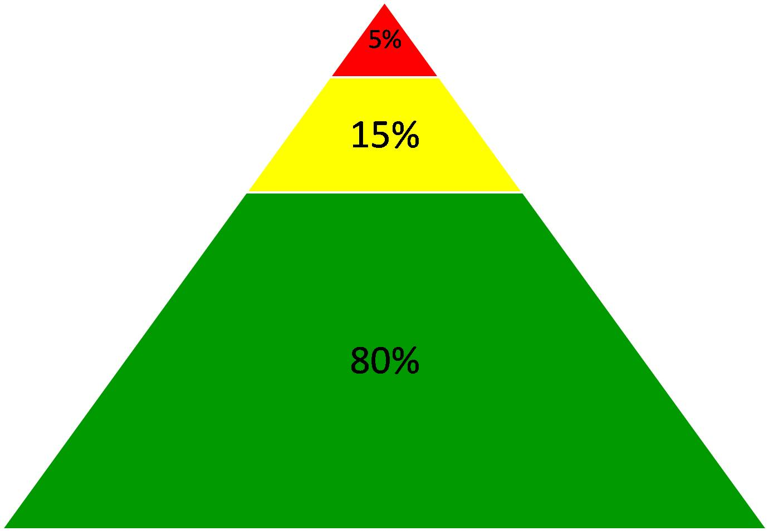
Comprehensive, Integrated, Three-Tier Model of Prevention (Lane, Kalberg, & Menzies, 2009)
Goal: Reduce Harm
Specialized Individual Systems
for Students with High-Risk
≈
Tertiary Prevention (Tier 3)
Goal: Reverse Harm
Specialized Group Systems
for Students At-Risk
≈
Secondary Prevention (Tier 2)
PBIS Framework
Goal: Prevent Harm
School/Classroom-Wide Systems for All Students, Staff, & Settings
≈
Validated Curricula
Validated Curricula
Primary Prevention (Tier 1)
Academic
Behavioral
Social
Notes:
In addition to the (hurricane slide)
Validated curricula aligned with validated curricula-An instructional approach to behavior that teaches the behaviors (i.e., respect, responsibility, best effort) that give teachers the time to provide instruction in academics and social competencies (character education)
A data-driven framework that can be used to
Monitor the overall level of risk and progress in the school as a whole
Identify students who may require additional supports in academic, behavioral, and social domains
A character education program that is an evidence-based program
Primary, secondary, and tertiary levels of prevention
Response-to-Intervention (RtI; Gresham, 2002; Sugai, Horner, & Gresham, 2002)
Positive Behavior Interventions and Supports (PBIS; Lewis & Sugai, 1999; Sugai & Horner, 2002)
Each level of prevention increases in intensity or magnitude
Systematic, data-driven method to identify and support student
All students are eligible for participation (Lane, Robertson, et al., 2006)
Tier 1: Approximately 80% of students respond to this level (Gresham, Sugai, Horner, Quinn, & McInerney, 1998; Sugai & Horner, 2006)
Examples of Primary Prevention
Validated literacy curricula
Violence prevention
Conflict resolution programs
Anti-bullying programs
Schoolwide social skills instruction
Character Education Programs
Tier 2: Students who do not respond to the primary prevention plan, 10-15% of students
Focused intervention to address academic, behavior, or social concerns:
Acquisition (can’t do)
Fluency (trouble doing)
Performance (won’t do)
Examples of Secondary Prevention
Small group instruction in anger management
Reading comprehension strategies
Tier 3:Students who do not respond to the primary or secondary prevention, 5-7% of students
Intensive individualized interventions
Examples of Tertiary Prevention
Functional assessment-based interventions (Umbreit, Ferro, Liaupsin, & Lane, 2007)
Multi-systemic Therapy program (MST; Schoenwald, Brown, & Henggeler, 2000)

Slide 13
Shared Features that Lend to Integration
Universal Screening
Progress Monitoring
Three-tiered Prevention Logic
Core, Supplemental and Intensive Instruction
Program Measures (Treatment Integrity/Fidelity and Social Validity)
Implementation Science
Data-based Decision Making
Team Based Approach
Academic, behavioral, and social
concerns co-occur and interact with
one another, therefore: It is important
that prevention and remediation
efforts address this interconnected
relationship (Lane & Wehby, 2002).

Slide 14
Consider Students’ Multiple Needs Simultaneously
Understand how multiple domains affect each other.
Integrate or blend domains at all areas of prevention.
Use multiple data sources to inform instruction and curriculum selection.
“Strategically blend and embedded” throughout day/curriculum.
As academic tasks become more difficult, students with skill deficits may increasingly use problem behavior to escape difficult tasks, limiting their access to academic instruction (McIntosh, Horner, Chard, Dickey, & Braun, 2008).

Slide 15
Making the Connections
Meeting Students’ Multiple Needs Simultaneously
Academic
Student behavior affects teacher behavior
Academic and behavioral difficulties often co-occur
Academic skills- based curriculum and instruction
Increasing academic engagement decreases disruptive and off-task behaviors
Behavior
Students arrive at school with differing behavioral skill-sets
An instructional approach to behavior teaches students the behaviors needed to be successful at school
A proactive approach to behavior increases instructional time
Social
Environments where students feel safe physically & instructionally
Social skills improve peer and teacher interactions during instructional activities
A
Notes:
Some of the components we would expect to be in place
We define these expectations in positively stated behavioral expectations
We don’t ever tell a child on Friday, “When you come back to school on Monday, you better know how to read!” Ridiculous to ask a child to do something they’ve never been taught—yet we do this with student behavior all the time.
We want schools to be a safe, positive place for all students
Social skills programs we are using have to be evidence-based
Should meet your state’s requirements for character ed
For best results, it should be a district-wide initiative
How it connects:
Lowering of affective filter when students feel safe
Improved peer interactions filter into instructional groups, as well
Teach the behavior and give students a chance to practice that behavior
Note that it says reinforce, not bribe—2 distinctly different things!
Important to think through these items as you plan for all students
Data drives decisions, just like in academics
And, like academics, we want to monitor progress
how this correlates with academics:
Not every child shows up academically on the same plane, behavior is no different
Explicit instruction of desired behaviors
Proactive vs. reactive

Slide 16
Activity Social Skills/Behavior Instruction
Approaching and teaching social skills and behavior as you do academics.

Slide 17
Activity Social Skills/Behavior Instruction
Approaching and teaching social skills and behavior as you do academics.
What are some instructional
strategies that could also be used
for social/behavioral instruction?

Slide 18
Application
Application readiness self assessment
Exploration/Readiness
Readiness Activities
Primary Intervention (Tier 1) Plan
Description of teacher & student strategies/ interventions
Tertiary Intervention (Tier 3) Grid
Secondary Intervention (Tier 2) Grid
Mission/Vision
Teacher, Student, Parent responsibilities –academic- behavior-social
Description of teacher & student strategies/ interventions
Entrance & Exit criteria
Entrance & Exit criteria
Assessment Schedule
District commitment
Action Plan
Core Content Curriculum
Intro to MTSS: CI3T
Prepare to build integrated plan
Evidence of exploration activities
Universal Screening
Evaluation Measures
Progress Monitoring
Treatment Integrity & Social Validity
Progress Monitoring
Treatment Integrity & Validity
Application/Exploration Year 1: Structure | Year 2: Implement | Year 3+: Refine
MTSS: CI3T Cohort Training Series or Inside the Build
Teams create a blueprint in year 1 for roll out to Faculty, Students & Staff in year 2.
Outside the Build
Implementation stage and data will guide outside the build early childhood – college and career ready professional learning topics.
Teams create a blueprint in Phase 1 for roll out to Faculty, Students & Staff in Phase 2.
Teams create a blueprint in Phase 1 for roll out to Faculty, Students & Staff in Phase 2.
Sample Readiness Early Childhood – College & Career Ready Professional Learning Topics:
Sample Readiness Early Childhood – College & Career Ready Professional Learning Topics:
Sample Readiness Early Childhood – College & Career Ready Professional Learning Topics:

Slide 19
≈
≈
≈
Academic
Behavioral
Social
Notes:
In addition to the (hurricane slide)
Validated curricula aligned with validated curricula-An instructional approach to behavior that teaches the behaviors (i.e., respect, responsibility, best effort) that give teachers the time to provide instruction in academics and social competencies (character education)
A data-driven framework that can be used to
Monitor the overall level of risk and progress in the school as a whole
Identify students who may require additional supports in academic, behavioral, and social domains
A character education program that is an evidence-based program
Primary, secondary, and tertiary levels of prevention
Response-to-Intervention (RtI; Gresham, 2002; Sugai, Horner, & Gresham, 2002)
Positive Behavior Interventions and Supports (PBIS; Lewis & Sugai, 1999; Sugai & Horner, 2002)
Each level of prevention increases in intensity or magnitude
Systematic, data-driven method to identify and support student
All students are eligible for participation (Lane, Robertson, et al., 2006)
Tier 1: Approximately 80% of students respond to this level (Gresham, Sugai, Horner, Quinn, & McInerney, 1998; Sugai & Horner, 2006)
Examples of Primary Prevention
Validated literacy curricula
Violence prevention
Conflict resolution programs
Anti-bullying programs
Schoolwide social skills instruction
Character Education Programs
Tier 2: Students who do not respond to the primary prevention plan, 10-15% of students
Focused intervention to address academic, behavior, or social concerns:
Acquisition (can’t do)
Fluency (trouble doing)
Performance (won’t do)
Examples of Secondary Prevention
Small group instruction in anger management
Reading comprehension strategies
Tier 3:Students who do not respond to the primary or secondary prevention, 5-7% of students
Intensive individualized interventions
Examples of Tertiary Prevention
Functional assessment-based interventions (Umbreit, Ferro, Liaupsin, & Lane, 2007)
Multi-systemic Therapy program (MST; Schoenwald, Brown, & Henggeler, 2000)

Slide 20
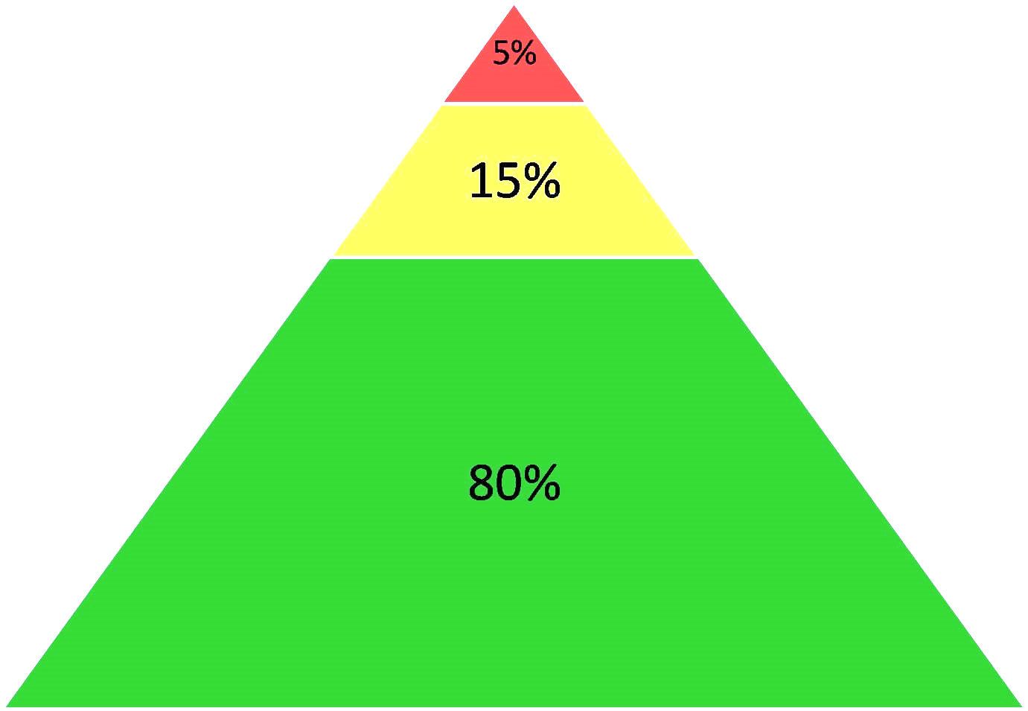
All students receive Tier 1
Core instruction: Reading, Math, and Social Skills
School-wide Behavior expectations developed
Universal Screeners: Reading, Math, and Behavior
Master Schedule with emphasis on maximizing instructional time
Academic
Behavioral
Social
Notes:
In addition to the (hurricane slide)
Validated curricula aligned with validated curricula-An instructional approach to behavior that teaches the behaviors (i.e., respect, responsibility, best effort) that give teachers the time to provide instruction in academics and social competencies (character education)
A data-driven framework that can be used to
Monitor the overall level of risk and progress in the school as a whole
Identify students who may require additional supports in academic, behavioral, and social domains
A character education program that is an evidence-based program
Primary, secondary, and tertiary levels of prevention
Response-to-Intervention (RtI; Gresham, 2002; Sugai, Horner, & Gresham, 2002)
Positive Behavior Interventions and Supports (PBIS; Lewis & Sugai, 1999; Sugai & Horner, 2002)
Each level of prevention increases in intensity or magnitude
Systematic, data-driven method to identify and support student
All students are eligible for participation (Lane, Robertson, et al., 2006)
Tier 1: Approximately 80% of students respond to this level (Gresham, Sugai, Horner, Quinn, & McInerney, 1998; Sugai & Horner, 2006)
Examples of Primary Prevention
Validated literacy curricula
Violence prevention
Conflict resolution programs
Anti-bullying programs
Schoolwide social skills instruction
Character Education Programs
Tier 2: Students who do not respond to the primary prevention plan, 10-15% of students
Focused intervention to address academic, behavior, or social concerns:
Acquisition (can’t do)
Fluency (trouble doing)
Performance (won’t do)
Examples of Secondary Prevention
Small group instruction in anger management
Reading comprehension strategies
Tier 3:Students who do not respond to the primary or secondary prevention, 5-7% of students
Intensive individualized interventions
Examples of Tertiary Prevention
Functional assessment-based interventions (Umbreit, Ferro, Liaupsin, & Lane, 2007)
Multi-systemic Therapy program (MST; Schoenwald, Brown, & Henggeler, 2000)

Slide 21
Some students in Tier 2
Targeted Interventions for Academics, Social Skills, and Behavior
Progress Monitors: Reading, Math, and Behavior
Extension activities for students whom do not need remediation
All students receive Tier 1
Core instruction: Reading, Math, and Social Skills
School-wide Behavior expectations developed
Universal Screeners: Reading, Math, and Behavior
Master Schedule with emphasis on maximizing instructional time
Academic
Behavioral
Social
Notes:
In addition to the (hurricane slide)
Validated curricula aligned with validated curricula-An instructional approach to behavior that teaches the behaviors (i.e., respect, responsibility, best effort) that give teachers the time to provide instruction in academics and social competencies (character education)
A data-driven framework that can be used to
Monitor the overall level of risk and progress in the school as a whole
Identify students who may require additional supports in academic, behavioral, and social domains
A character education program that is an evidence-based program
Primary, secondary, and tertiary levels of prevention
Response-to-Intervention (RtI; Gresham, 2002; Sugai, Horner, & Gresham, 2002)
Positive Behavior Interventions and Supports (PBIS; Lewis & Sugai, 1999; Sugai & Horner, 2002)
Each level of prevention increases in intensity or magnitude
Systematic, data-driven method to identify and support student
All students are eligible for participation (Lane, Robertson, et al., 2006)
Tier 1: Approximately 80% of students respond to this level (Gresham, Sugai, Horner, Quinn, & McInerney, 1998; Sugai & Horner, 2006)
Examples of Primary Prevention
Validated literacy curricula
Violence prevention
Conflict resolution programs
Anti-bullying programs
Schoolwide social skills instruction
Character Education Programs
Tier 2: Students who do not respond to the primary prevention plan, 10-15% of students
Focused intervention to address academic, behavior, or social concerns:
Acquisition (can’t do)
Fluency (trouble doing)
Performance (won’t do)
Examples of Secondary Prevention
Small group instruction in anger management
Reading comprehension strategies
Tier 3:Students who do not respond to the primary or secondary prevention, 5-7% of students
Intensive individualized interventions
Examples of Tertiary Prevention
Functional assessment-based interventions (Umbreit, Ferro, Liaupsin, & Lane, 2007)
Multi-systemic Therapy program (MST; Schoenwald, Brown, & Henggeler, 2000)

Slide 22
A Few students in Tier 3
Specialized Interventions for Academics, Social Skills, and Behavior
Frequent Progress Monitors: Reading, Math, and Behavior
Is not only reserved for Special Education
Some students in Tier 2
Targeted Interventions for Academics, Social Skills, and Behavior
Progress Monitors: Reading, Math, and Behavior
Extension activities for students whom do not need remediation
All students receive Tier 1
Core instruction: Reading, Math, and Social Skills
School-wide Behavior expectations developed
Universal Screeners: Reading, Math, and Behavior
Master Schedule with emphasis on maximizing instructional time
Academic
Behavioral
Social
Notes:
In addition to the (hurricane slide)
Validated curricula aligned with validated curricula-An instructional approach to behavior that teaches the behaviors (i.e., respect, responsibility, best effort) that give teachers the time to provide instruction in academics and social competencies (character education)
A data-driven framework that can be used to
Monitor the overall level of risk and progress in the school as a whole
Identify students who may require additional supports in academic, behavioral, and social domains
A character education program that is an evidence-based program
Primary, secondary, and tertiary levels of prevention
Response-to-Intervention (RtI; Gresham, 2002; Sugai, Horner, & Gresham, 2002)
Positive Behavior Interventions and Supports (PBIS; Lewis & Sugai, 1999; Sugai & Horner, 2002)
Each level of prevention increases in intensity or magnitude
Systematic, data-driven method to identify and support student
All students are eligible for participation (Lane, Robertson, et al., 2006)
Tier 1: Approximately 80% of students respond to this level (Gresham, Sugai, Horner, Quinn, & McInerney, 1998; Sugai & Horner, 2006)
Examples of Primary Prevention
Validated literacy curricula
Violence prevention
Conflict resolution programs
Anti-bullying programs
Schoolwide social skills instruction
Character Education Programs
Tier 2: Students who do not respond to the primary prevention plan, 10-15% of students
Focused intervention to address academic, behavior, or social concerns:
Acquisition (can’t do)
Fluency (trouble doing)
Performance (won’t do)
Examples of Secondary Prevention
Small group instruction in anger management
Reading comprehension strategies
Tier 3:Students who do not respond to the primary or secondary prevention, 5-7% of students
Intensive individualized interventions
Examples of Tertiary Prevention
Functional assessment-based interventions (Umbreit, Ferro, Liaupsin, & Lane, 2007)
Multi-systemic Therapy program (MST; Schoenwald, Brown, & Henggeler, 2000)

Slide 23
A Few students in Tier 3
Specialized Interventions for Academics, Social Skills, and Behavior
Frequent Progress Monitors: Reading, Math, and Behavior
Is not only reserved for Special Education
Some students in Tier 2
Targeted Interventions for Academics, Social Skills, and Behavior
Progress Monitors: Reading, Math, and Behavior
Extension activities for students whom do not need remediation
All students receive Tier 1
Core instruction: Reading, Math, and Social Skills
School-wide Behavior expectations developed
Universal Screeners: Reading, Math, and Behavior
Master Schedule with emphasis on maximizing instructional time
Academic
Behavioral
Social
Notes:
In addition to the (hurricane slide)
Validated curricula aligned with validated curricula-An instructional approach to behavior that teaches the behaviors (i.e., respect, responsibility, best effort) that give teachers the time to provide instruction in academics and social competencies (character education)
A data-driven framework that can be used to
Monitor the overall level of risk and progress in the school as a whole
Identify students who may require additional supports in academic, behavioral, and social domains
A character education program that is an evidence-based program
Primary, secondary, and tertiary levels of prevention
Response-to-Intervention (RtI; Gresham, 2002; Sugai, Horner, & Gresham, 2002)
Positive Behavior Interventions and Supports (PBIS; Lewis & Sugai, 1999; Sugai & Horner, 2002)
Each level of prevention increases in intensity or magnitude
Systematic, data-driven method to identify and support student
All students are eligible for participation (Lane, Robertson, et al., 2006)
Tier 1: Approximately 80% of students respond to this level (Gresham, Sugai, Horner, Quinn, & McInerney, 1998; Sugai & Horner, 2006)
Examples of Primary Prevention
Validated literacy curricula
Violence prevention
Conflict resolution programs
Anti-bullying programs
Schoolwide social skills instruction
Character Education Programs
Tier 2: Students who do not respond to the primary prevention plan, 10-15% of students
Focused intervention to address academic, behavior, or social concerns:
Acquisition (can’t do)
Fluency (trouble doing)
Performance (won’t do)
Examples of Secondary Prevention
Small group instruction in anger management
Reading comprehension strategies
Tier 3:Students who do not respond to the primary or secondary prevention, 5-7% of students
Intensive individualized interventions
Examples of Tertiary Prevention
Functional assessment-based interventions (Umbreit, Ferro, Liaupsin, & Lane, 2007)
Multi-systemic Therapy program (MST; Schoenwald, Brown, & Henggeler, 2000)

Slide 24
Benefits of Participating in the MTSS: CI3T Training Series
A customized blueprint for guiding systems change to empower each student (early childhood through college and career ready) to achieve high standards in reading, math, behavior (PBIS framework) and social skills.
A three year series of no-cost* high-quality professional learning led by state trainers and coaches.
Systematic, team-based, data-driven method to identify and support students.
Procedures and tools for monitoring progress of MTSS: CI3T plan and assessing fidelity and social validity.
Improved family engagement.
Training for a district and building coach(es) to sustain the work.
Guided professional learning opportunities to support in-depth knowledge and sustainability.
Networking opportunities across the state.
*Districts might incur costs such as substitutes, purchasing curriculum and universal screener, software and professional learning outside the training scope and sequence.
Notes:
Universal Screening
Progress Monitoring
Three-tiered Prevention Logic
Core, Supplemental and Intensive Instruction
Program Measures (Treatment Integrity/Fidelity)
Implementation Science
Data-based Decision Making
Team Based Approach

Slide 25
Sample Cohort Organization for a 10 building district or 3 small districts
MTSS: CI3T State Trainer
(social/behavior expertise)
MTSS: CI3T State Trainer
(academic expertise)
MTSS: CI3T
State Coach
District Coach
District Coach
District Coach
Building Team
Building Team
Building Team
Building Team
Building Team
Building Team
Building Team
Building Team
Building Team

Slide 26
MTSS: CI3T Cohort Training Series
3 Year Inside the Build Process
Year 1: Structure
Session 1
Session 2
Session 3
Session 5
Session 4
Session 6
6 Full Days
Year 2: Implement
Session 1
Session 2
Session 3
Session 5
Session 4
Session 6
Up to 6 Full Days
Year 3+
Refine/
Sustain
Session
1
Session
2
Session
3
Other Professional Learning and TA as needed.
3 Full Days

Slide 27
Resources
Kansas MTSS www.kansasmtss.org
CI3T www.ci3t.org
PBIS www.pbis.org
Recommended Reading

Slide 28
Contact Information
Kansas MTSS: CI3T
www.kansasmtss.org
kansasmtssci3t@keystonelearning.org
Save the Date: 2015 Kansas MTSS Symposium September 3-4, 2015 in Wichita, KS

