Slide 1
The State of Assessments Beth Fultz, Assistant Director of Assessments and Accountability

Slide 2
Kansas Student Population Trends
Notes:
TM: These are the unaudited enrollment counts.

Slide 3
How did we get here?

Slide 4
NCLB State Assessment Footprint

Slide 5
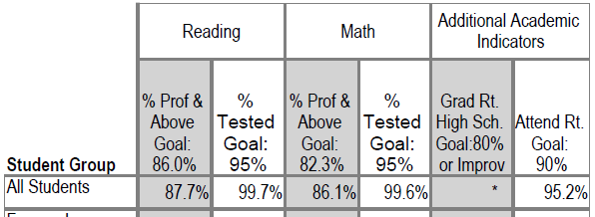
What were the results?
2012 State Assessment Results

Slide 6
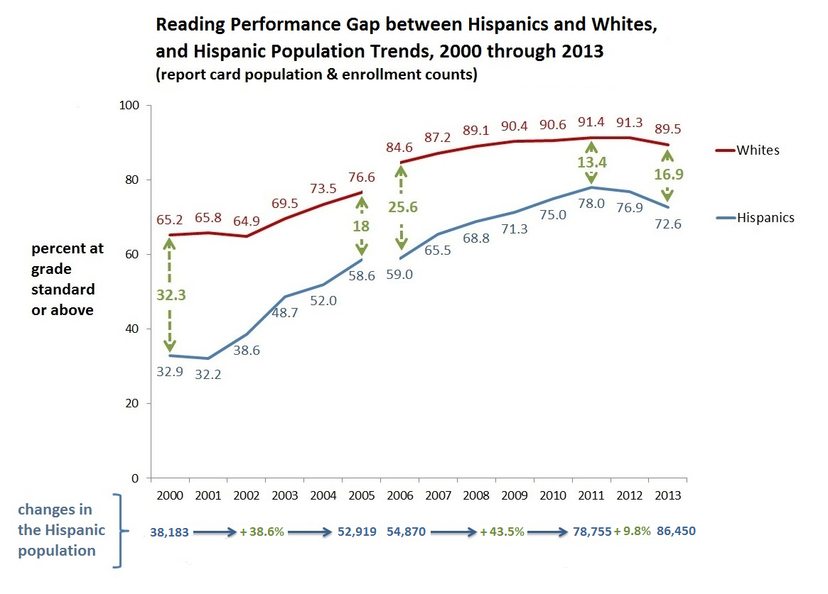
6
Notes:
The population counts here, after 2009, have been slightly inflated by a change in the federal method for counting Hispanics.

Slide 7
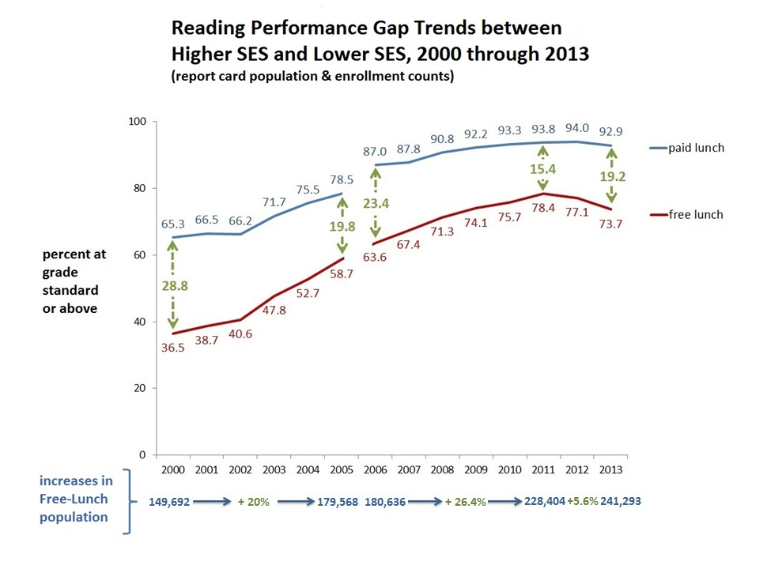

Slide 9
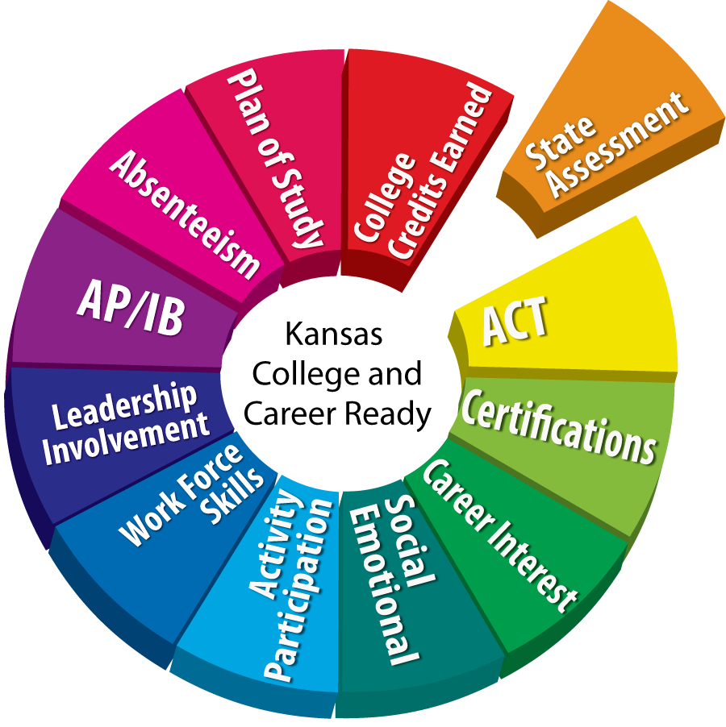
Measuring “College and Career-Ready”
A
A
C
E
A
C
T
T
E
CCR = ACTE

Slide 10
COLLEGE AND CAREER READY means an individual has the academic preparation, cognitive preparation, technical skills, and employability skills to be successful in postsecondary education, in the attainment of an industry recognized certification or in the workforce, without the need for remediation.
CCR = ACTE

Slide 11
Kansas College and Career Ready Footprint

Slide 12
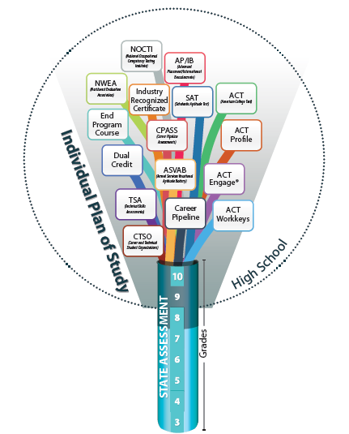

Slide 13
Where are we now?
Going into our 5th year of transitioning to College & Career Ready Standards in Math and English Language Arts (ELA)
Second year of transitioning to new College & Career Ready Standards in Science and History/Government.
Kansas will administer new Assessments in Math and ELA in Spring of 2015.
AYP Targets are GONE… Now focusing on GROWTH OVER TIME
The Kansas ESEA Waiver has been approved for another year.

Slide 14
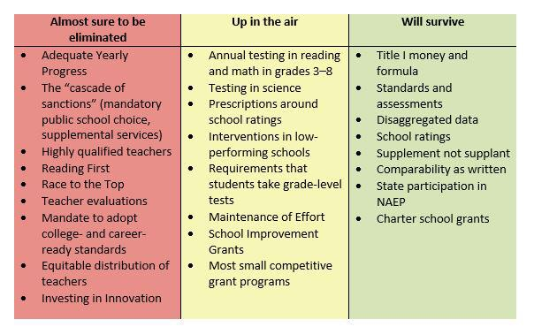
ESEA Reauthorization … When? Whether?

Slide 15
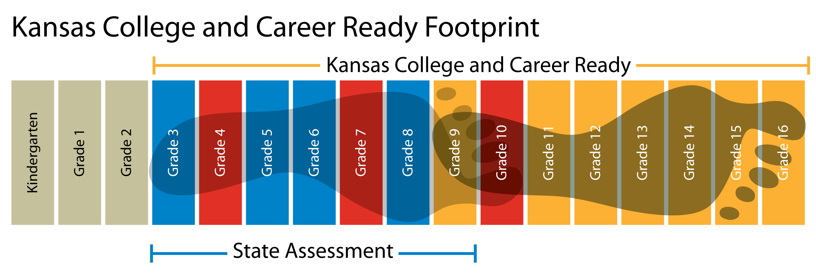
Future Footprints After ESEA Reauthorization?

Slide 16
Back to Reality

Slide 17
March 9 – May 15, 2015
Math and ELA
Grades 3-8 and 10
Machine scored multiple choice and technology enhanced items aligned to the KCCRS
4 parts (tickets/sessions) each
Field Test – Grades 3-8 only
Math performance task (one ticket/session)
MDPT – (writing task) aligned to English Language Arts, History/Government/Social Studies & new Science standards

Slide 18
2015 (continued)
History/Government/Social Studies
FIELD TEST (not optional)
Grades 6, 8 & 11
Machine scored multiple choice and technology enhanced items aligned to the KCCRS
2 parts (tickets) ONE (1) session
PLUS: Grade 11 performance task (MDPT)
2 parts (tickets/sessions)
Science
Grades 4, 7, 11
Machine scored multiple choice items
Old science assessment items aligned to new KCCR
Science Standards

Slide 19
2015 (continued)
Alternate Assessments – Dynamic Learning Maps
Final testing window March 16-May 15
Grades 3-8 and 10
ELA and math
Science DLM - pilot assessment
Testing window April 22-May 15
History/Government/Social Studies – pilot assessment
Kansas assessment, not part of DLM
KELPA-P
February 3 – May 1
cPass
October 1 – May 15

Slide 20
Fall 2015
Field Test
Listening Items aligned to ELA KCCRS
Voluntary
Operational section of ELA assessment – spring 2016

Slide 21
2016 Stage Adaptive Test

Slide 22
Scoring
Who can be a KAP Scorer?
We are looking for scorers who are:
A classroom teacher in one of these content areas:
English Language Arts, grades 3-8
Science, grades 3-8
Social studies, grade 3-8, 11
Mathematics, grades 3-8
Teachers of English as a Second Language, grades 3-8, 11
Teachers of Special Education, grades 3-8, 11

Slide 23
Scoring
Time Commitment
Complete 2-hour online training certification after April 1, 2015.
Score student answers for at least 10 students (expect 6-10 minutes per essay and 3-5 minutes for each math task) on (most) PC or Apple computers from home or school.
Operational scoring opens April 1, 2015 and continues through May 29, 2015.

Slide 24
Why will it take so long to get scores?
Standard Setting
Mid-July content experts (teachers) will be guided through a process to set cut scores
Performance Level Descriptors
Toward the end of July a group of policy leaders will review the recommendations of the standard setting group
August 11 or 12 the recommendations will be presented to the Kansas State Board of Education
Hopefully – September 8 or 9 Vote by the State Board
Results will be released as soon as possible after the State Board decision.
Accountability Report Card release in Oct. or Nov.

Slide 25
ksassessments.org

Slide 27
KAP Website
http://ksassessments.org/

