Slide 1

KEEN Conference
February 2016
Kent Reed, School Counseling

Slide 2
Anti-Bullying Awareness Week
And
Bullying Data Report
---------------------------
State Board of Education
October, 2015

Slide 3


Slide 4
Submitted Anti-Bullying Activities
Release Forms
School Web Pages
School Newsletters
Lesson Plans
“Shake It OFF” Video
Kindness Games
Theme Weeks
Twitter, Instagram
You Tube Videos
Lip Dub Videos
Art Projects
T-Shirt Designs
Assemblies
Local Media Events

Slide 5
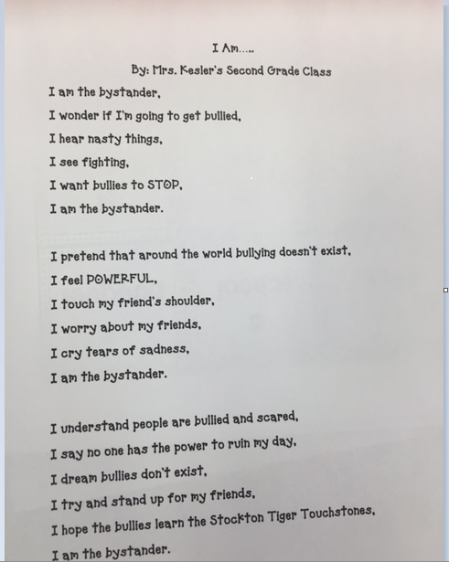
Stockton Grade School, USD 271

Slide 6
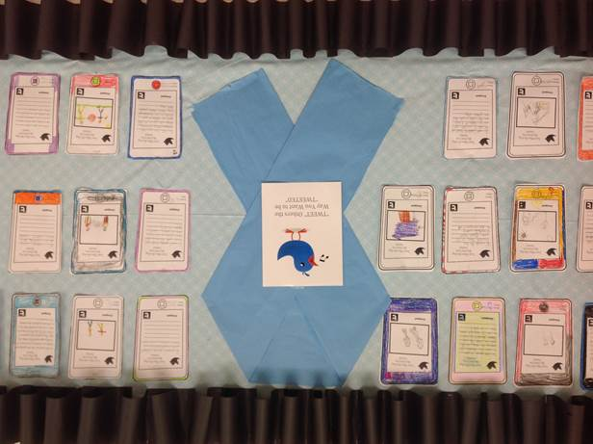
“Tweet Others As You Would Want To Be Tweeted”
Seaman USD 345

Slide 7
Notes:
KAN-DIS is the KSDE application that collect discipline data including bullying. This is the 4 year trend data.

Slide 8

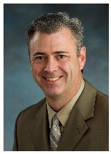

Creating a Vision for Kansas

Slide 9
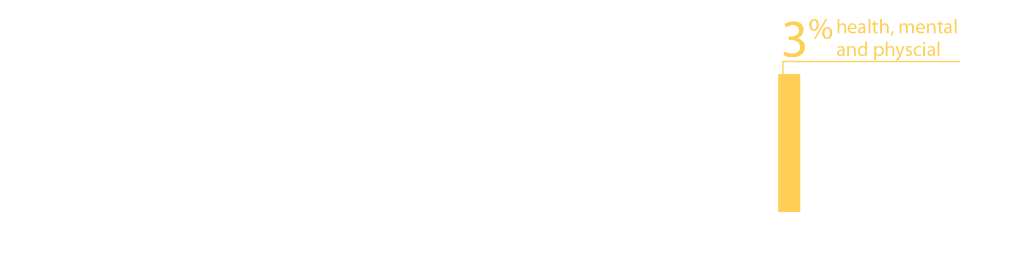
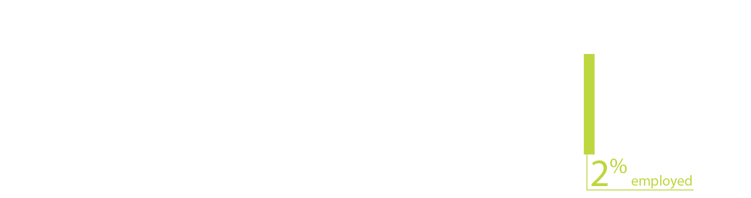
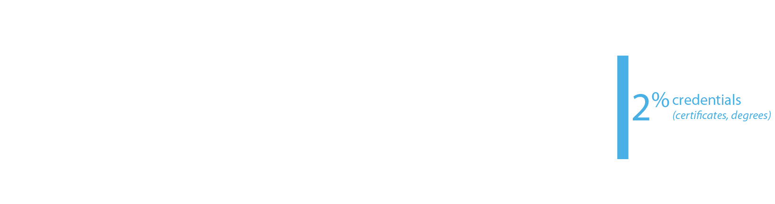
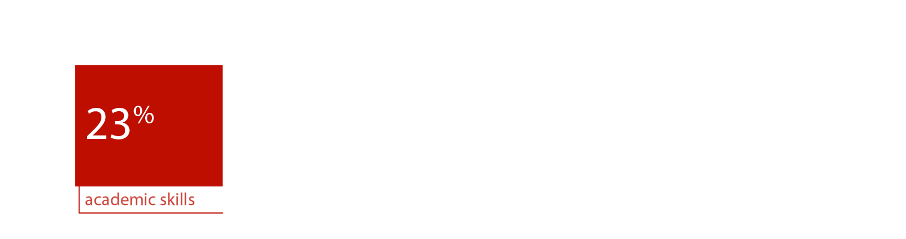

From the first set of focus group responses, what characteristics of success were most frequently cited?
Notes:
This result is a little surprising since about 66% of the respondents were educators, education administrators, or former educators—people who mostly teach, or used to teach, academic skills. Nevertheless, the soft skills—social-emotional, personality skills, or 21st century skills—they have lots of names—were cited 70% of the time.

Slide 10
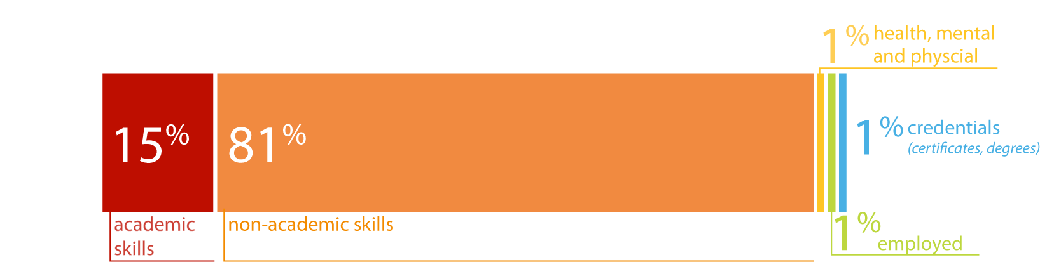
The business and industry focal groups cited non-academic skills with greater frequency than the community groups:
Notes:
Recall that the community groups cited non-academic skills 70% of the time and academic skills 23% of the time. These frequencies are remarkably similar to those expressed by the community groups. If volume can be equated with importance, the business and industry groups are saying that the non-academic characteristics are more important than academic skills, including applied skills, and that non-academic skills are at least as important to them as to the community groups, maybe more so.
One cited experience as a characteristic of the ideally prepared 24 year old (the tiny yellow line).

Slide 11
A few take-home lessons
What is the role of K-12 education in achieving the future?
Re-designing the curriculum—
around individualized goals, planning,
instruction, and experience, around
incorporating real-life problems and projects into
the curriculum, and experiential learning—is heavily suggested.
New roles are suggested for school counselors—in deeper individual career planning, and perhaps in coordinating internships and work experiences with business and community organizations.
The large proportion of instrumental skill training that included some experiential training, e.g. internships; concrete, realistic practice, job shadowing, etc.—suggests much more integrated coordination with businesses and community organizations.
School climate is important but not well-defined.
Notes:
There is a suggestion of a structure of social opportunities—opportunities for experience, particularly real-world experiences—that students need to practice applied skills, both practical and social.

Slide 12
Creating a Vision for Kansas
What should we focus on?
  Academic Readiness related to college and career readiness
  Psycho-Social behavior related to college and career readiness
  Character education related to future success
  Matching career choice with passion of student
  Have students involved in activities (2-5)
  Have students involved in volunteerism
  Every student has an individual plan of study
  Make pre-school available to every student

Slide 13
Other mutually agreed upon characteristics are:
Critical thinking
Openness (adaptability, independence, creativity)
Communication skills
Group skills like teamwork and
Citizenship and moral obligations to others.
Traditional academic skills and applied skills are important, but less frequently cited than the non-academic skills listed above.

Slide 14
Board Outcomes Relative
To School Counseling
Academic Advising
Individual Plans of Study
Social-Emotional Learning
Family Engagement

Slide 15
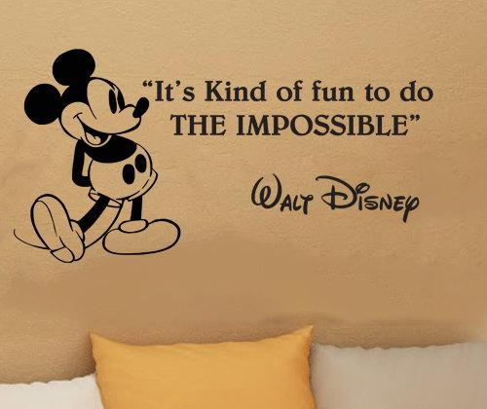
Creating a Vision for Kansas

Slide 16
The Problem
Current counselor to student ratio is 1:400
The ASCA recommended ratio is 1:250
Factors/variables to consider that impact counseling services: funding, mandates, assignments, demographics, shortage, of licensed school counselors

Slide 17
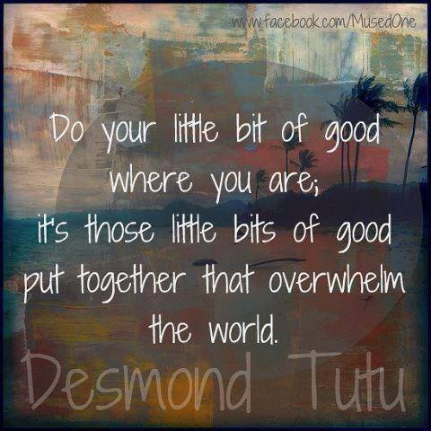

Slide 18
Social-Emotional Character Development

Slide 19
What Is It?
Social: Human relations and interactions
Emotional: Feelings and behavior
Character Development: Success skills

Slide 20
Social and emotional learning (SEL) is the process through which children and adults acquire the knowledge, attitudes, and skills necessary to understand and manage emotions, set and achieve positive goals, feel and show empathy for others, establish and maintain positive relationships, and make responsible decisions. Social and emotional skills are critical to being a good student and citizen.
- CASEL, 2015

Slide 21
Perspective
Emotional Intelligence : Daniel Golman
Character Education: Elias et. al.
Consortium for the Advancement of Social Emotional Learning
KSA 72-8256
Partnership in Character Education Grant
Safe and Supportive Schools Grant
Duckworth (GRIT); Dweck (Growth Mindsets)
Community and Business/Industry Conversations

Slide 22
SEL Indicators
Attitude and behavior
Attendance and program completion
Bullying prevention
Character development
School based mental health
Volunteerism/service learning
Climate/student management
Success skill development
Prevention
Notes:
This is why SEL is so hard to measure, all of these are formative rather than summative indicators

Slide 23

Kansas State Board of Education (KSBOE)
Mission:
To prepare Kansas students for lifelong success through rigorous, quality academic instruction, career training and character development according to each student’s gifts and talents.
Notes:
The Board has identified 5 goals for this year. Two that I would highlight would include:
Goal 1 - Provide a flexible and efficient delivery system to meet our students’ varied and changing needs
Goal 2 - Provide an effective educator in every classroom
Goal 3 - Ensure effective, visionary leaders in every school
Goal 4 - Promote and encourage best practices for early childhood programs
4.1 Define early childhood education
4.2 Research scientifically based early childhood programs to determine best practices
4.3 Ensure parents/guardians have access to best practices research and how to identify and access early childhood education for their children
4.4 Identify and establish relationships with organizations interested in early childhood education
4.5 Advocate for universal early childhood education
5. Develop active communication and partnerships with families, communities, business stakeholders, constituents and policy partners
5.1 Align PreK-20 systems of support and identify and remove roadblocks in collaboration with identified partners
5.2 Educate and inform the public regarding education issues
5.3 Develop strategic partnerships with stakeholders

Slide 24
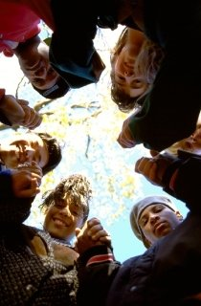
Kansas Model Curricular Standards for School Counseling
School Counseling Standards
State Board Meeting
Spring 2015
Notes:
Kansas education is standards driven; the school counseling standards provide schools with the framework for the comprehensive school counseling program.

Slide 25
Standards Framework
Social-emotional domain
Career development domain
Academic domain
Arranged by grade level
  K-2; 3-5; 6-8; high school

Slide 26
Social/Emotional Domain
Overview: These standards guide school counseling programs to help students manage emotions and learn and apply interpersonal skills.
Standard 1: The student will acquire knowledge, attitudes, and interpersonal skills to help them understand and respect self and others.
Standard 2: The student will make decisions, set goals, and take necessary action to achieve goals.
Standard 3: The student will understand personal safety skills.

Slide 27
SOCIAL, EMOTIONAL, AND CHARACTER DEVELOPMENT STANDARDS…
ANOTHER KANSAS FIRST!!!

Slide 28
Why SECD?
Aligns with the Social-Emotional Domain of the Ks. Curricular School Counseling Standards
21st Century Accreditation Model (Responsive Culture)
Rose Standards (School Finance Case/Appropriations Bill)
How can students academically achieve when they are dealing with bullying, cutting, divorce, single parents, teen suicide, teen dating violence, substance abuse and mental health issues?
College and Career Ready

Slide 29
Kansas Social, Emotional, Character Development Standards
Approved by State Board April 2012
Ks. was the first state to adopt
Social –emotional learning integrated with character development
Notes:
The standards writing committee borrowed from Golman’s “Emotional Intelligence” model and existing best practices in character development

Slide 30
Durlak Research
Meta-Analysis of SEL programs involving 270,034 Kindergarten – High School Students
SEL Participants demonstrated significantly improved social and emotional skills, attitudes, behavior, and academic performance that reflected an 11-percentile-point gain in achievement.
Durlak JA, Weissberg RP, Dymnicki AB, Taylor RD, Schellinger KB., The impact of enhancing students' social and emotional learning: a meta-analysis of school-based universal interventions.
Notes:
Highlight the 11 percentile point gain in Achievement!!!!

Slide 31
PCEP IMPACT
A continuing multi-year experimental research study
in over 50 Kansas high schools has shown
the following results between 2008-2010:
Increased math achievement
Narrowed reading achievement gap between experimental and control schools
Significant decline in suspensions and expulsions

Slide 32


Character Development
  Core Principles
  Responsible Decision Making and Problem Solving
  Social Awareness
  Interpersonal Skills
  Self -Awareness
  Self-Management
Social Skills Development
Personal Skills Development
Kansas Social, Emotional, and Character Education Standards
Career, Standards, &
Assessment Services
Notes:
Character Development, Personal Development, and Social Development are separate STRANDS of the Standards but are VERY much interrelated and dependent on the other strands. The Sub-headings under those three Strands are…..Core Principles and Responsible Decision Making and Effective Problem Solving under Character Development…Under Personal Development is Self-Awareness and Self-Management and under Social Development…Social Awareness and Interpersonal Skills. This follows the pattern of the Core Curriculum for English Language Arts

Slide 33
College and Career Ready Goal
KCCRS component…
Students who are college and career ready must identify and demonstrate well-developed social-emotional skills and identified individual and community core principles that assure academic, vocational, and personal success.

Slide 34
Curriculum
Examples

Slide 35
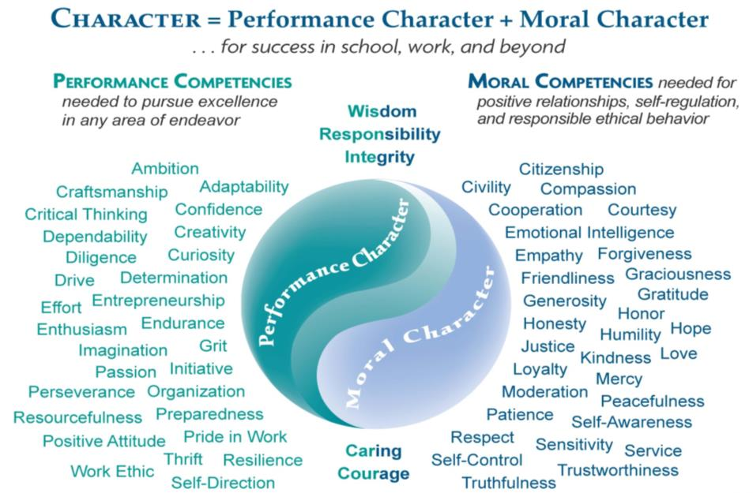
Notes:
Power 2 Achieve Curriculum, Institute for Excellence and Ethics- When we talk about the power of character, we’re really talking about the power that comes from the values we put in action. We can drill down even more to talk about two parts of character: performance character and moral character. Performance character consists of the values we put into action in order to do our best. Moral character consists of the values we put into action in order to have positive, productive, and ethical relationships.

Slide 36
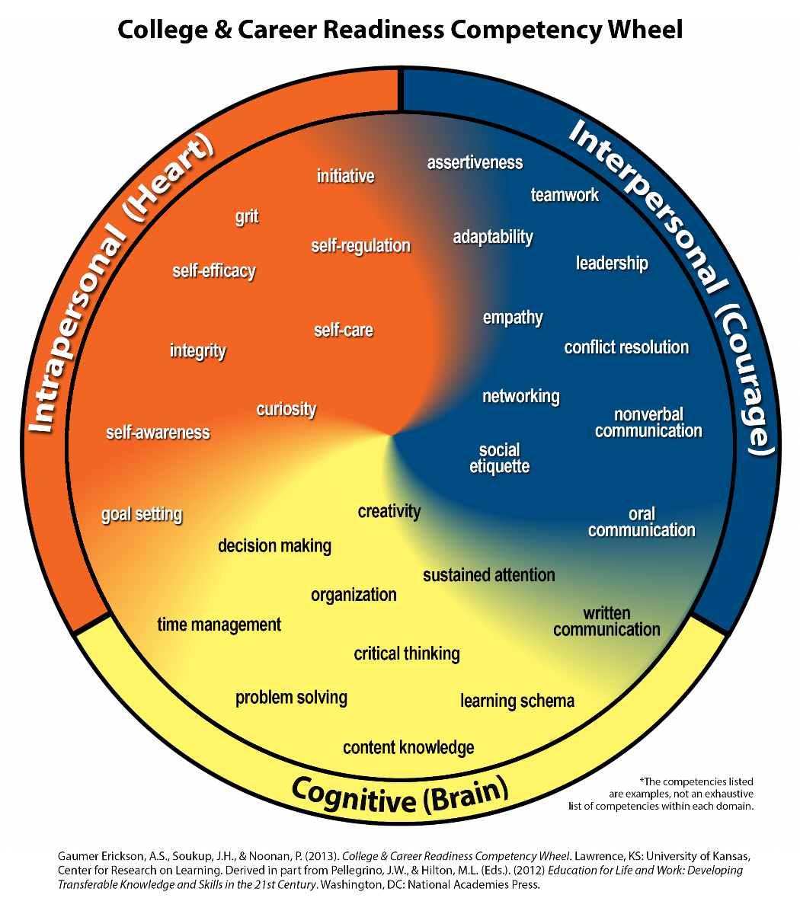
*Gaumer Erickson & Noonan, University of Kansas, Center for Research on Learning (2015)
Notes:
Here is one option for how to look more closely at lessons to teach in these areas
Let’s talk a little more specifically about Grit. Grit is tenacity, determination – but those are still very abstract. It is the ability to keep trying or push through when you have made a mistake or you don’t feel as confident about your abilities. Example of my 12 year old wanting to be hoisted by his middle school team at an adventure/team building course over the 12 foot wall. I was scared to death. He is a lineman in football. He is my size and my weight. He is not a running back, wide receiver, cross country runner. He is large, but he was determined and SO WAS HIS TEAM to get him over the wall. Together they worked, each person had a role and a job. When they couldn’t get it to work the first time, they adjusted the jobs and the second time they got him over. IT WAS AWESOME to see. But more importantly did they learn or use multiple of these skills listed in this wheel, yes!!!! In school, they can use these skills as well. You don’t need a 12 foot wall to do it. Encouraging and setting up systems that allow students to master content through acknowledging their mistakes, finding out how to correct them, and having the opportunity to correct them without frustration and repeat the accurate way of doing the task – this teaches grit, self-regulation, conflict resolution, etc.

Slide 37
Habits of Mind
One of the three “keys for success” stressed in the Kansas College and Career Ready Standards
  Habits of Mind
  Collaboration
  Focus on Instruction

Slide 38
Habits of Mind
1. Persisting
2. Managing impulsivity
3. Listening with understanding and empathy
4. Thinking flexibly
5. Thinking about your thinking
6. Striving for accuracy
7. Questioning and problem solving
8. Applying past knowledge to new situations
9. Thinking and communicating with clarity and precision.
10. Gather data through all senses.
11. Creating, imagining, and innovating
12. Responding with wonderment and awe
13. Taking responsible risks
14. Finding humor
15. Thinking interdependently
16. Remaining open to continuous learning
    Bena O. Kallick & Arthur L. Costa
Notes:
Habits of Mind, research by Bena O. Kallick and Arthur L. Costa and published by ASCD is a HIGHLY respected look at those “habits” necessary for success in life…and are one of the three components stressed in the Kansas Common Core Curriculum Standards…Habits of Mind, Collaboration, and Focus on Instruction!!!
“How do these Habits of Mind align with YOUR successful person?”
These are the Habits of Mind used by Kansas Core Curriculum…ELA and Math folks. Their 3 keys for success are…Habits of Mind, Collaboration, and Focus on Instruction – Habits of Mind are almost all character traits…

Slide 39
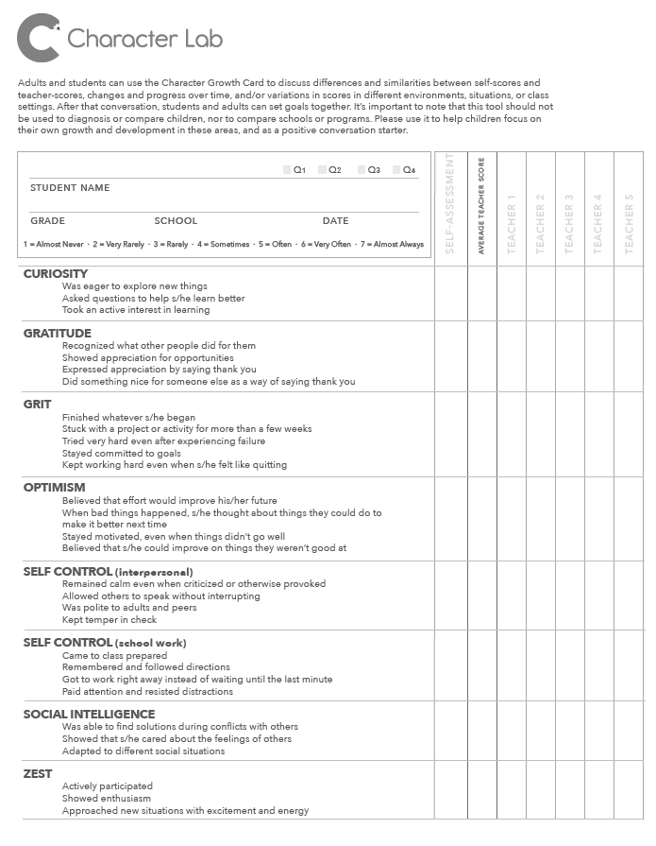
Notes:
Angela Duckworth’s/Character Lab “Growth Card”

Slide 40
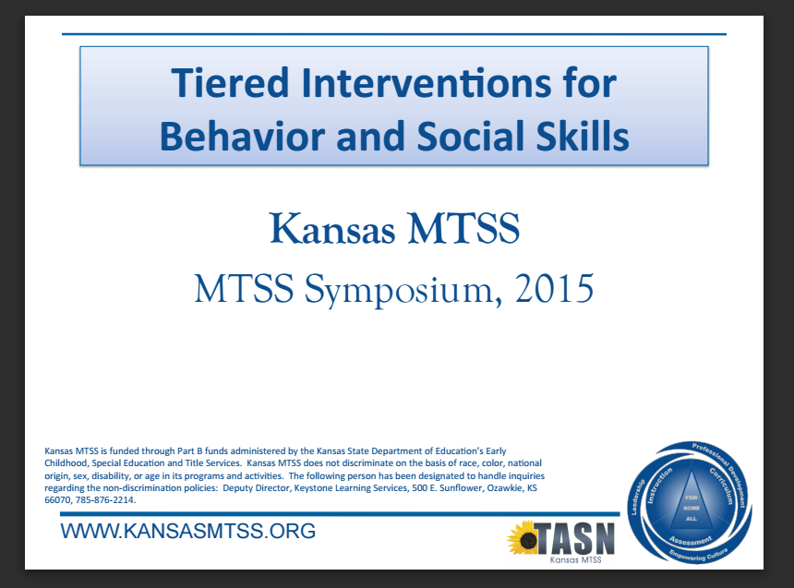

Slide 41
KSDE Recommendations
Follow school improvement process
Assess your needs
Evidence based
Tiered approach
Use data to inform decision making
Multiple measures for evaluation

Slide 42
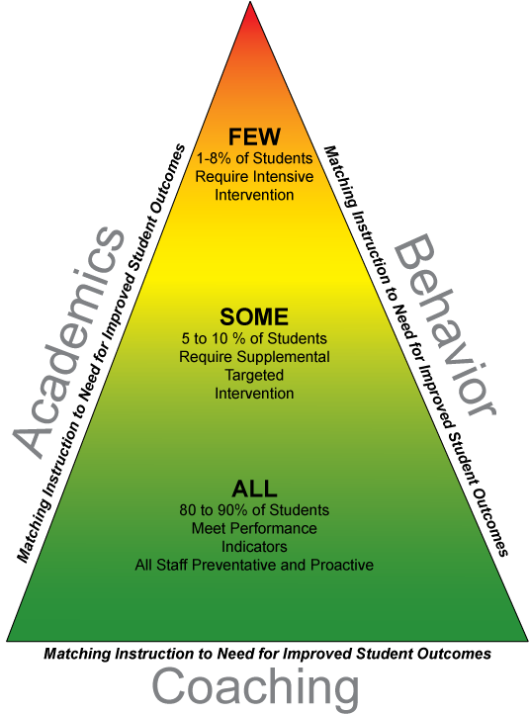
Career, Standards, &
Assessment Services

Slide 43
How Do You Teach?
Perseverance
Leadership
Drive
Craftsmanship
Enthusiasm
Grit
Hope
Problem Solving

Slide 44


Slide 45
How do you teach it?
Example it
Mentor it
Integrate it
Model it
Measure and evaluate it
I was recently asked “how do you teach love in school?”

Slide 46
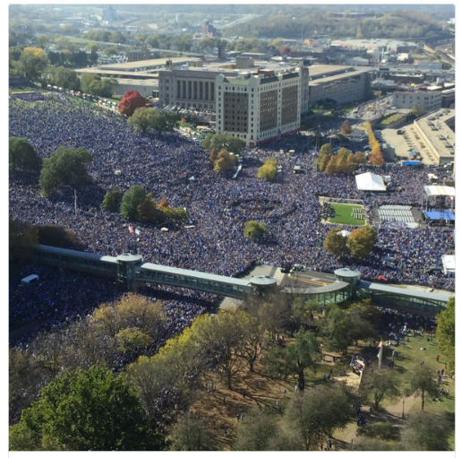

Slide 47
Kansas Schools of Character
Awards
Character Education Partnership (CEP) Grant
11 Principles of Character Education
Applications are submitted and reviewed
Honored over 50 Kansas Schools this past May
Sue Kidd, Coordinator for Kansas Character Development Initiative, at skidd.kschared@gmail.com or Topeka City of Character at http://www.topekacharacter.org/kansas-school-of-character.html

Slide 48
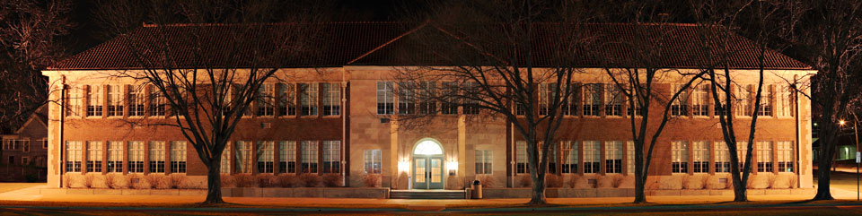

Monroe Elementary School
Career, Standards, &
Assessment Services
Notes:
We are where we are because the students and parents of Monroe Elem. had courage and persistence (Brown vs. Board, Linda Brown)

Slide 49
Measuring SECD

Slide 50
Data
Process data: what you did for whom
Perception data: what do people think, know, believe or can do?
Outcome data: so what? Have we reached our outcome?

Slide 51
Collected KSDE data
    KAN-DIS
    KIDS
    Climate Index
Commercial products
Duckworth’s Growth Card
Universal Screeners
Dr. Kathleen Lane- KU

Slide 52
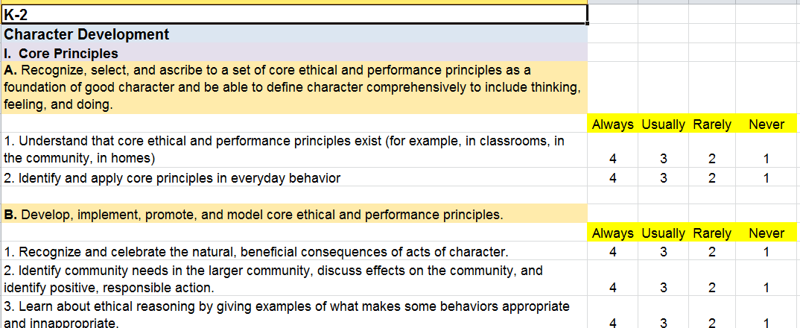
Student Growth Measures
For
SECD
Notes:
Likert scale developed by SECD Cadre (Noalee McDonald-Augustine).

Slide 53
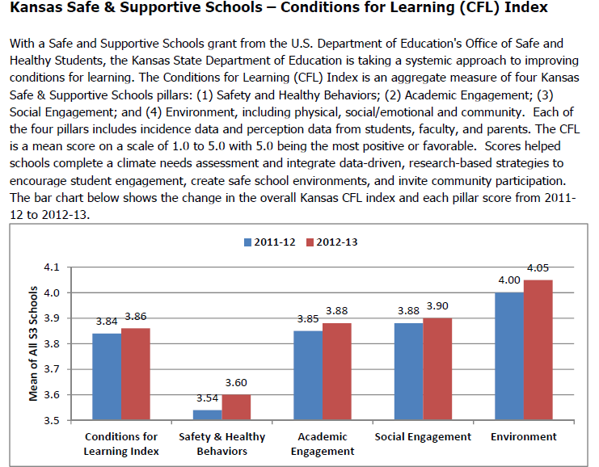

Slide 54
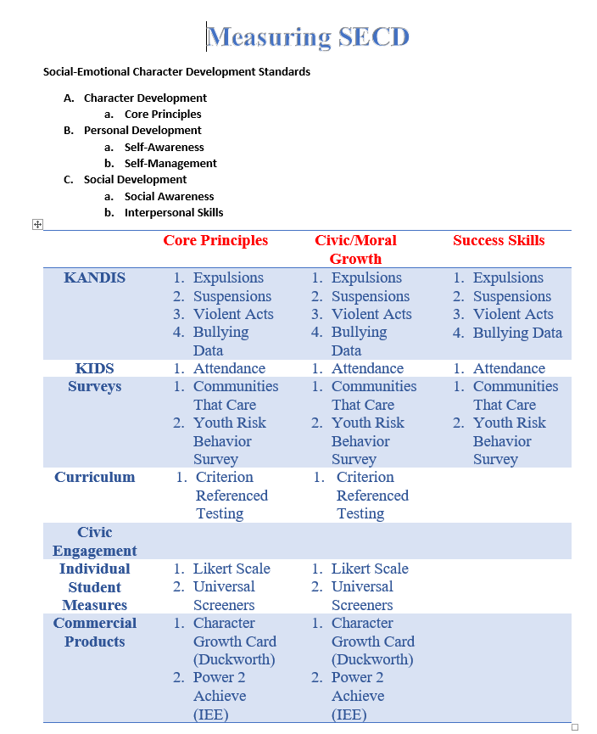

Slide 55
Accountability
Notes:
This is a work in progress ….

Slide 56
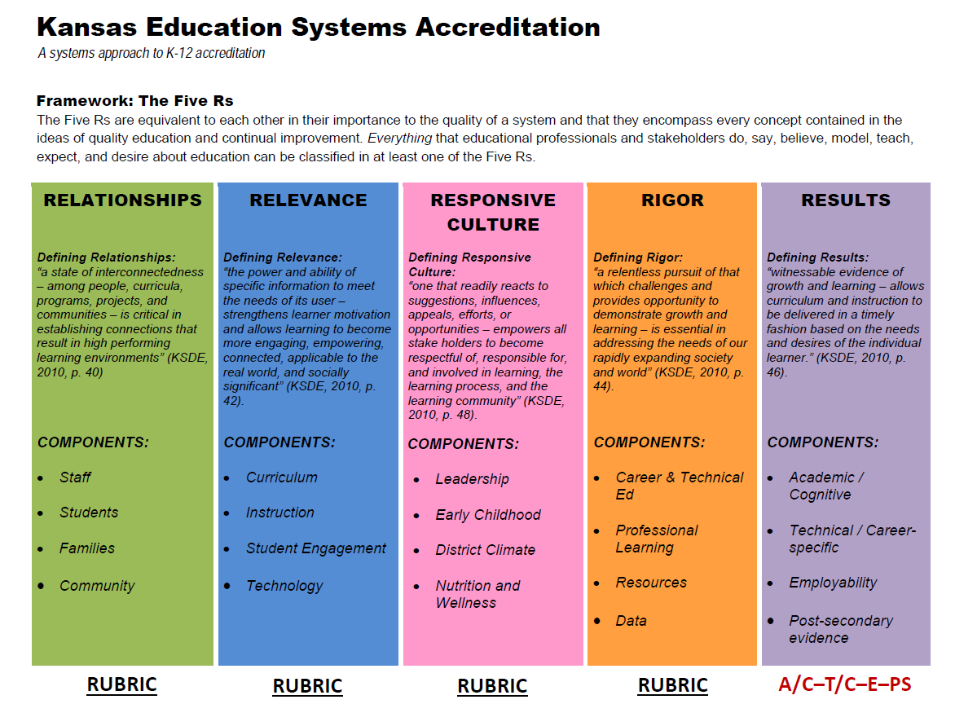

Slide 57
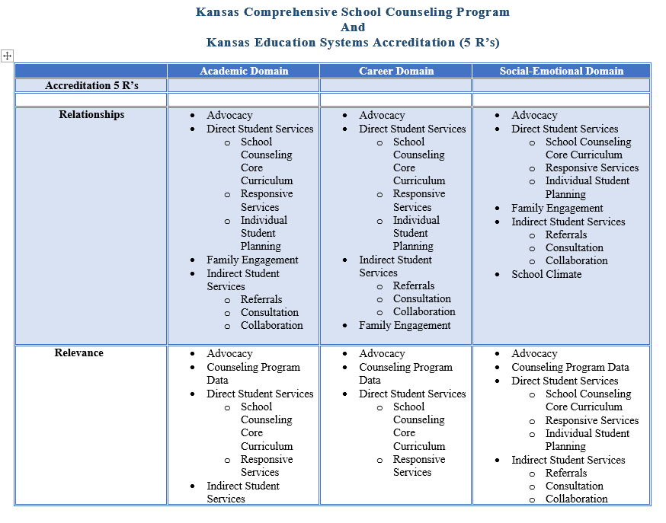
Notes:
This is a crosswalk between the 5 R’s and the 3 counseling domains for a conversation Randy had with 10 building principals and their counselors.

Slide 58
Student Growth Measures
Measure what the student does, not the counselor/staff
Current measures are formative, there is no summative measure for SEL nationally or statewide
Utilize multiple measures to drive decision making
Current collected SEL measures: KAN-DIS (i.e. suspensions, expulsions, discipline referrals, bullying incidents)
Other measures: attendance, volunteerism, honor roll, number of eligible students registered to vote
Implemented curriculum data (i.e. Growth Card, Power 2 Achieve Character Counts, etc.)
)

Slide 59
School Counselor Evaluation Rubric
 | Career Domain | Social-Emotional Domain | Academic Domain
Instructional Practices
Growth Measures

Slide 60
Resources

Slide 61


Slide 62
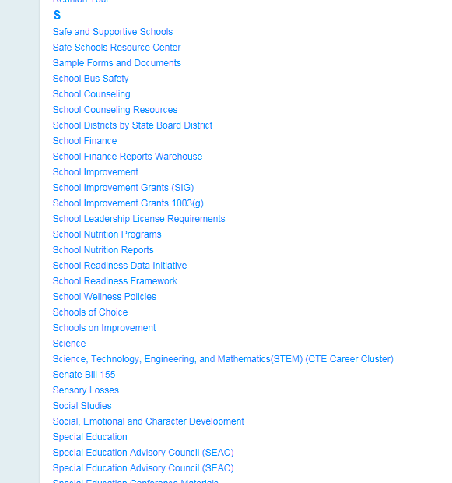

Slide 63
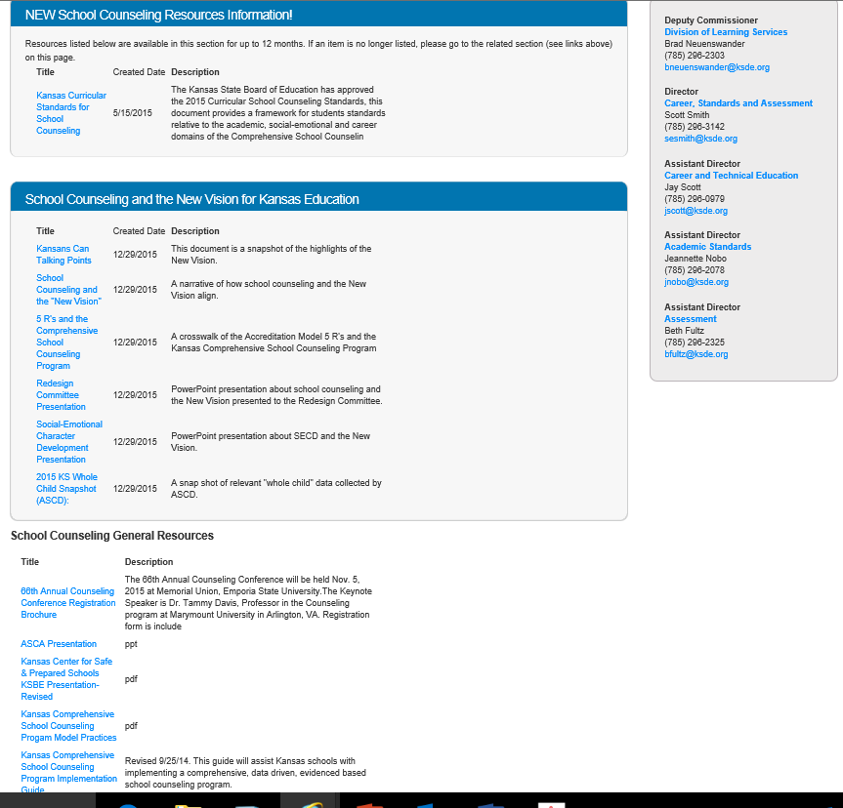

Slide 64
Resources
CASEL (www.casel.org)
Kansas Character Development Initiative (http://www.kssecd.org/)
Edutopia (http://www.edutopia.org/social-emotional-learning?gclid=CP_9hMmk8sgCFVU2aQodY98IMg)
Character Lab (https://characterlab.org/)
Character.org (http://character.org/)
Growth Mind Sets (http://qedfoundation.org/fixed-vs-growth-mindsets/)
Measuring SEL- Univ. of Minnesota (http://www.extension.umn.edu/youth/research/sel/docs/issue-brief-measurement-resource.pdf)
Topeka City of Character
  http://www.topekacharacter.org/kansas-school-of-character.html
TASN (WWW.KANSASMTSS.ORG)
ASCD (http://www.ascd.org/professional-development/pls/social-emotional-learning-and-character-education.aspx)
Committee for Children (http://www.cfchildren.org/second-step/social-emotional-learning)
Whole Child (AIR) (http://www.gtlcenter.org/sites/default/files/TeachingtheWholeChild.pdf)
KSDE Sites (www.ksde.org)

Slide 65
Thanks for all that you do for Kansas kids!!
------------------------------
Kent Reed
785-296-8109
kreed@ksde.org

