Slide 1
Technology
Games
Gamification
KEEN CONFERENCE 2016
Dillon Buck
Cearra Jones
Edward Franco
Amy Ramirez-Spears

Slide 2
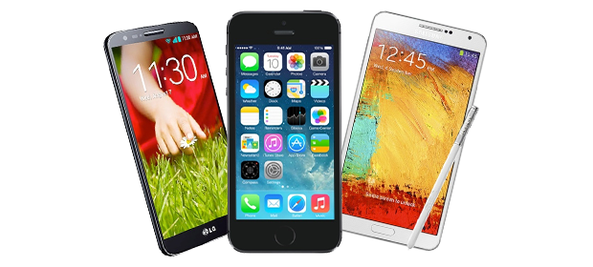
Majority of US households own 4 digital devices
- Entertainment Software Association

Slide 3
US consumers spend
60 hours a week
(US Digital Consumer Report)

Slide 4
67% - teens own a
53% - tweens have their own
- (Common Sense Media)

Slide 5
9 hours – teens & social media
6 hours - tweens & social media
- (Common Sense Media)

Slide 6
100% of schools have computers with Internet access.
89% of high school students have access to internet-connected smart phones
92% of teachers access content, resources & materials online
96% of teachers feel comfortable using technology in their classroom

Slide 7
The future our students will inherit is one that will be mediated and stitched together by the mobile web, and I think that ethically, we are called on to teach them how to use technology effectively, to ensure that they end up on the right side of the digital divide: the side that knows how to use technology to learn & band together. Teaching digital literacy seems to be as crucial as teaching basic literacy.
- David Parry (2011), On Teaching Mobile Literacy

Slide 8
Technology & Games – platforms, apps & online tools for learning
Gamification – the use of game design elements to non-game contents.

Slide 9
- It is an online resource that provides opportunities for learners to engage in social, fun and game like activities.

Slide 11
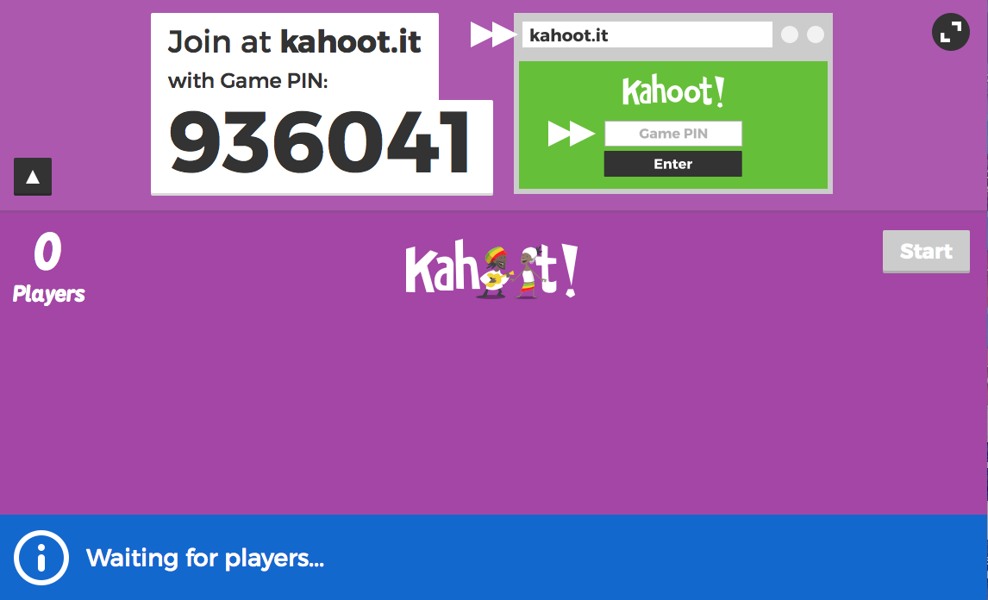
Teachers: https://getkahoot.com

Slide 12
Students: Kahoot.it

Slide 13
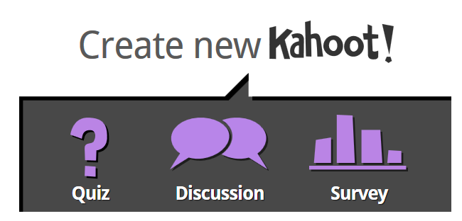
Go to: Kahoot.it

Slide 14
VoiceThread

Slide 15
VoiceThread
It’s an application that allows users to post media artifacts for community feedback.
Online discussion threads

Slide 16
Go to : voicethread.com

Slide 17
Sample Voicethreads
http://voicethread.com/myvoice/#thread/7078020/37632509/38824976
https://voicethread.com/myvoice/#thread/7077926/37632179/38924651
http://voicethread.com/share/7089492/ Example
http://voicethread.com/myvoice/#thread/7078042/37632682/38868070
http://alexherecon.blogspot.com/?zx=98e7ac6293b76e58
Blog Example

Slide 18
Gamification

Slide 19
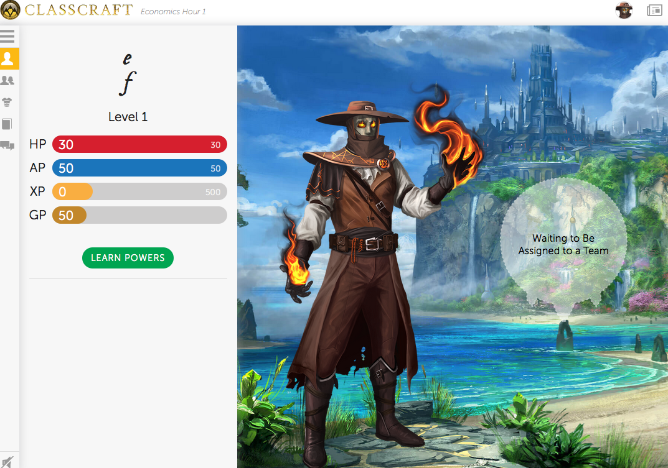

Slide 20
Rewards & Consequences
XP (Experience Points) – rewards for smart thinking, good behavior & performance
Every ____ XP, you level up and gain powers

Slide 21
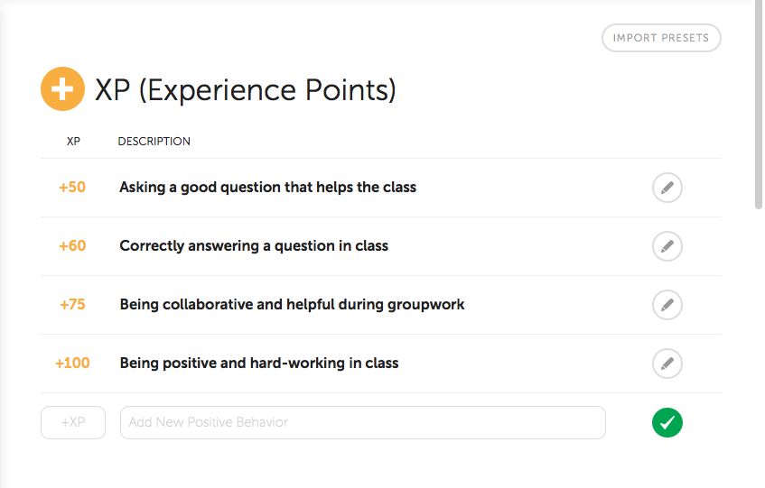
Experience Points

Slide 22
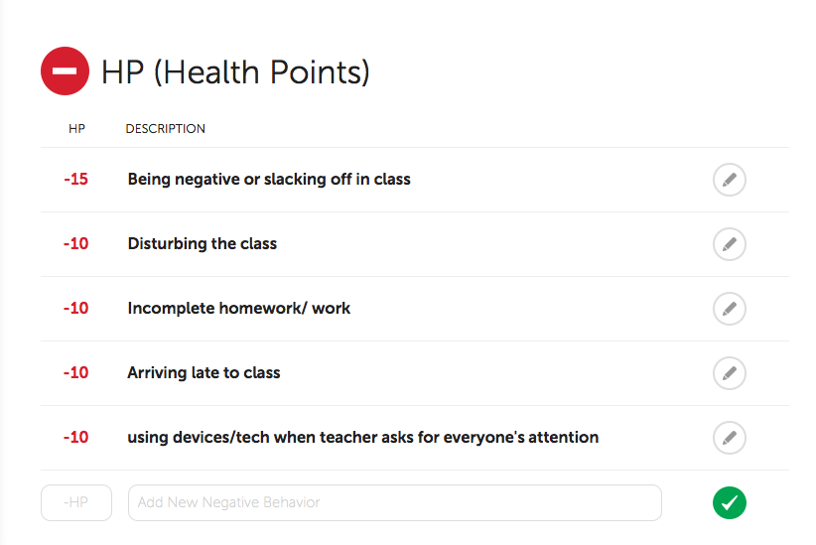
Rewards & Consequences
HP (Health Points) – consequences

Slide 23
Rewards & Consequences
AP (Action Points) – get to use your powers
Everyday you gain AP
Whenever you use your powers, AP decreases
When AP is below unacceptable amounts, you will suffer a consequence.

Slide 24
The Mage – AP
Mana Transfer – members gain AP.
Invisibility – can skip a bellwork and still earn points.
Teleport – trade places with any classmate.
Clairvoyance – Team can get a hint on an/ some exam question(s).

Slide 25
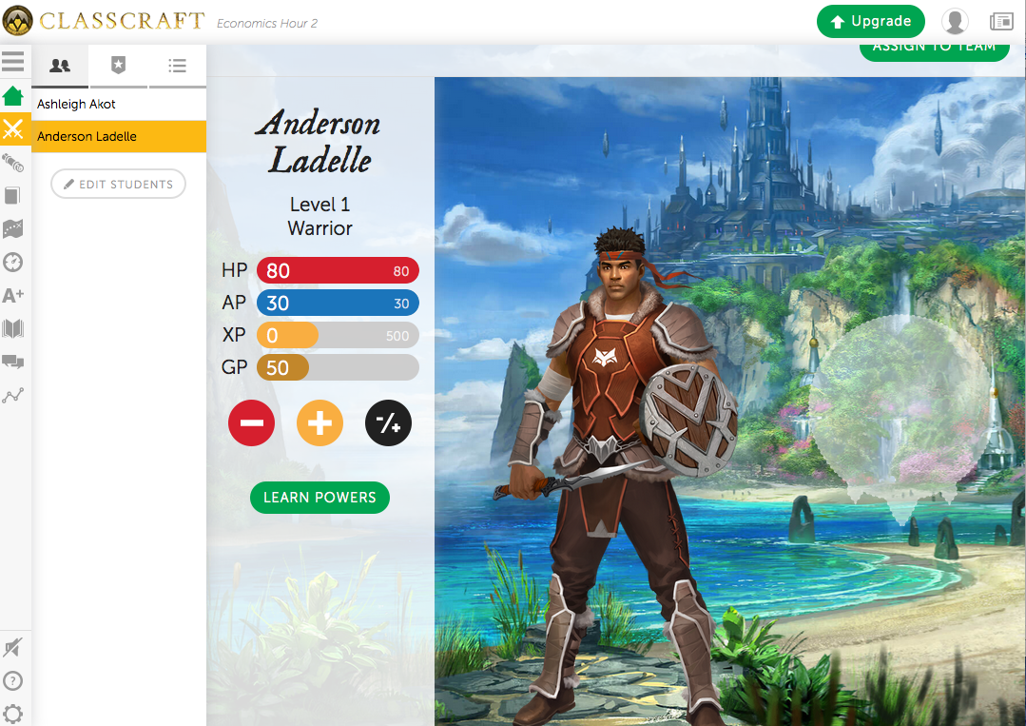
The Warrior - HP
Protect – warrior take teammate’s damage
Savage – skip a bellwork and still earn points
Ambush – can hand in late assignments w/o deductions
Frontal Assault All team members can hand assignment without deduction

Slide 26
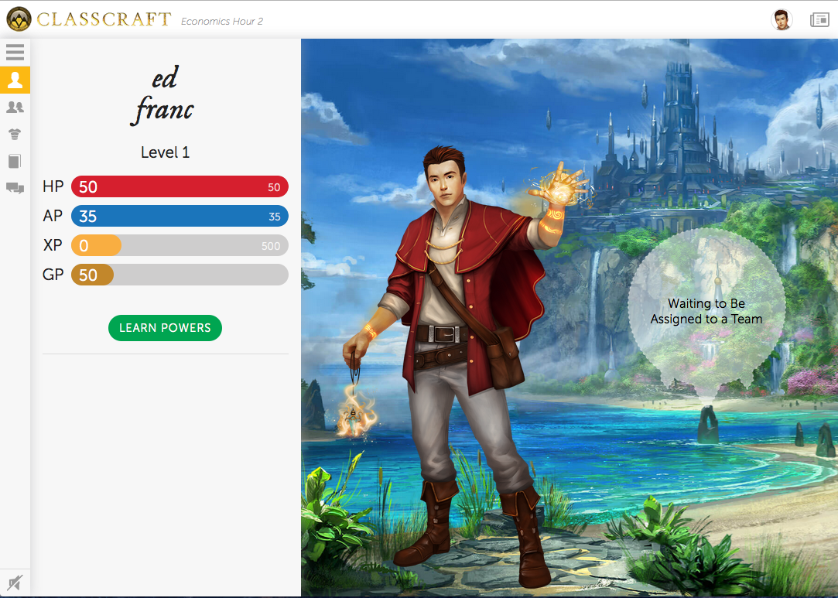
The Healer - balanced
Heal
– member gain health points
Ardent Faith – During PA, ask if the answer is correct
Prayer – can access notes during PA
Sainthood – skip a bellwork and still earn points.

Slide 27
Steps to Gamify from Edutopia
Use a gamification software such as:
Gradecraft,
3DGameLab,
Classcraft
The VirtualLocker
Prepare Quests and Gamified Strategies

Slide 28
Steps to Gamify
Points & Reward Systems
(Experience Points, Health Points, etc.)
Provide various alternative projects to encourage voice and choice
Award Badges/ Level Ups/ Powers

