Slide 1
Ignite! Inspiring Excellence Through the Conative Skills
Cheryl Wright, USD 500 – cheryl.wright@kckps.org
Brandi Leggett, USD 512 – brandileggett@smsd.org

Slide 2
Learning Goals
After attending this session, participants will have:
A clear understanding of conative skills and
Essential information describing how to align conative skills with academic strategies to promote student success

Slide 3
#1 - Quick Write
Retrieved from imagesource

Slide 4
Academic Focus
What is it that students should know and be able to do?
How will we know when students know it and are able to do it?
What do we do when we discover that students don’t know it and are not yet able to do it?
~ Grant Wiggens and Jay McTighe (1998)

Slide 5
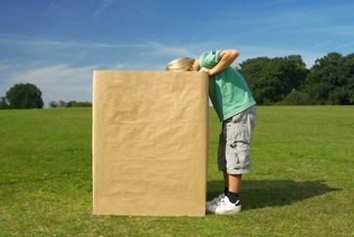
So, in the equation of effective instruction . . .
Retrieved from imagesource
How does one denote conative skills?

Slide 6
Often Referred to as Soft Skills
Non- cognitive Skills
or
Essential Skills . . .

Slide 7
Conative Skills
“ . . . inform how people work with each other. Few standards govern this aspect of education, and yet it might be the greatest factor determining whether a student becomes successful in college and the global workplace.”
- Sterling, Learning Sciences International

Slide 8
Instructional Shift
“We now have hard evidence that you have to have soft skills [conative skills] in order to succeed.”
“While the dimensions of success in American life have been the test score . . . this should not be the main measure.”
Research indicates that while this is important, non-cognitive skills such as: Sociability, Communication, Self-Control, Motivation, Resilience are of equal importance.
- Heckman, University of Chicago
Notes:
https://www.youtube.com/watch?v=yKzQYQNtYts
http://heckmanequation.org/content/resource/presenting-heckman-equation

Slide 9
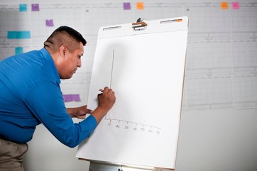
Current Research in Kansas
“ . . . Across the state, less than ¼ of [participants surveyed] put traditional academic skills at the top of their list . . . while 70% put what are commonly referred to as “soft-skills,” such as how to introduce one’s self in a business setting, or how to act on a job site, at the top of the list.
-Kansans CAN
Retrieved from imagesource

Slide 10
Conative Skills Focus on Students’ Abilities to:
Interpret situations
Cultivate a growth mindset
Develop resiliency or grit
Avoid negative thinking
Take various perspectives on an issue
Interact responsibly with other people
Handle controversy and resolve conflict
Develop goals and commitments (intentions and goals)

Slide 11
How do conative skills naturally fit into the Common Core?
Example standards:
Participate in collaborative discussions with diverse partners about grade 2 topics and texts with peers and adults in small and larger groups
Acknowledge differences in the points of view of characters
Distinguish their own point of view from that of the narrator or those of the character
Engage effectively in a range of collaborative discussions building on other’s ideas and expressing their own clearly

Slide 12
How can we teach “GRIT” when students only want to quit?

Slide 13
Perseverance Walk
Perseverance Walk
Presentation should include:
Goal person set
Obstacles and roadblocks person encountered
What their subject’s life became once their goal was achieved

Slide 14
Powerful Words
Process-driven language
Focus feedback on effort instead of outcome
Ex: Focus on how really worked through a complex text and used reading strategies, rather than on the “A”
A goal hasn’t been mastered “yet”

Slide 15
S.M.A.R.T. Goals
Setting meaningful, intentional goals. Students pick a goal and fill out each category.
S - Specific
M - Measurable (students quantify process. Ex. Finish 100 multiplication facts in two minutes)
A - Attainable (possible, within reach, practical)
R - Relevant (pertains to the student, something they want to do)
T – Time Sensitive (set a specific timeline with checkpoints along the way)

Slide 16
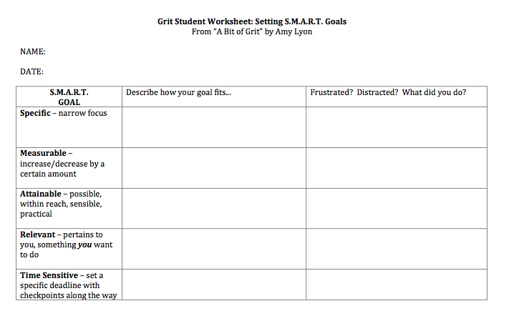

Slide 17
Weekly Reflection Journals
Self-rating journal entries
Something new I learned
This week’s memorable moment
Something I struggled with
Daily G.L.O.W.
Goal for tomorrow
Something learned today
Something outstanding that happened
Something I had to work through today

Slide 18
Community Meetings
Class-wide discussions about grit
Provide students with news article or cartoon ahead of time. Have them think about why grit mattered and why it should matter to them.

Slide 19
Genius Hour
Passion-driven learning, where students are in control of their learning
Students identifying their passions
Students developing their own driving questions
Students developing “how” they will learn more about their passion

Slide 20
#2- What are Your Thoughts?
How can we explicitly blend conative skills into classroom instruction?
Taking Different Perspectives
Avoid Negative Thinking
Instruction
Interacting Responsibly
Effective Communication
Cultivating a Growth Mindset
Resolving Conflict
Develop Resiliency or Grit

Slide 21
#3 - Checking for Understanding
After attending this session, participants have:
A clear understanding of conative skills and
Essential information describing how to align conative skills with academic strategies to promote student success
Next Steps . . .

Slide 22
Making Connections . . .
Albert Einstein
Thank you!

